Slide 1
Compliance Conversations
ProBank Education Services
April 13, 2026

Slide 2

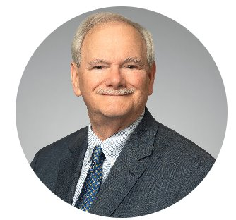
Compliance Conversations
ProBank Education Services
Presenters
Mark Burnside, CRCM
Director, Kentucky
Mark Dever, AAP, CAMS
Director, Kentucky

Slide 3
TO RECEIVE CPE CREDIT
Attendees must respond to at least 3 of the 4 polling questions per CPE hour.
Attendees must be logged in for a minimum of 50 minutes per every CPE hour.

Slide 4

Compliance Conversations
Polling Questions
1.Would you be interested in receiving information about our quarterly InCompliance newsletter?
Yes
No

Slide 5
Compliance Conversations
ProBank Education Services
2025 Fair Lending Interagency Webinar – December 16, 2025
With participation by the Federal Reserve, the NCUA and the CFPB, the panel discussion included comments regarding ongoing priorities for each agency.
https://www.consumercomplianceoutlook.org/Outlook-Live/2025/2025-Fair-Lending-Interagency-Webinar/
The Federal Reserve started by stating that they conduct “risk focused consumer compliance exams and reviews for fair lending risk at every exam” as part of determining “whether further analysis is warranted” and proceeded to highlight specific areas like pricing and underwriting risk in addition to providing examples of Supervisory Expectations, Root Causes and Sound Practices.

Slide 6
Compliance Conversations
ProBank Education Services
2025 Fair Lending Interagency Webinar – December 16, 2025
The NCUA primarily focused on:
1. Fair Lending Compliance Management Systems
2. Home Mortgage Disclosure Act (Regulation C)
3. Equal Credit Opportunity Act (Regulation B)

Slide 7
Compliance Conversations
ProBank Education Services
2025 Fair Lending Interagency Webinar – December 16, 2025
Although the CFPB emphasized their ongoing concerns around fair lending with the statement that Fair Lending Statutory Mandates, including the mandate to ensure fair, equitable, and nondiscriminatory access to credit for both individuals and communities as well as ensuring that consumers “have access to markets for consumer financial products and services and that markets for consumer financial products and services are fair, transparent, and competitive.” They also noted that their main priority going forward will be focused on the Executive Order on Debanking, including establishing a Debanking Task Force and assigning dedicated resources to the effort.

Slide 8
Compliance Conversations
ProBank Education Services
Focus on Compliance Risk
From Compliance Management Systems, establishing a “Culture of Compliance” at every level of an institution and increased discussions around conducting Risk Assessments to determine where risk exists in our institutions, making sure we spend the time, effort, and resources toward compliance risk management is more important than ever.

Slide 9
Compliance Conversations
ProBank Education Services
Focus on Compliance Risk
The compliance examination manual/procedures is one of the best resources institutions have available as part of this discussion.
The purpose of the examination process is to identify risk within an institution and make a subjective decision about the effectiveness of an institution's structures, processes, and controls in managing that risk.
Laws and Regulations tell us what we have to do (or not do) and how to comply.
The examination procedures give us a clearer picture of regulatory expectations and what controls they feel are most effective in managing risk.

Slide 10
Compliance Conversations
ProBank Education Services
Treasury/FinCEN are proposing to modernize the Bank Secrecy Act (BSA) and to implement provisions of the Anti-Money Laundering Act of 2020 (AML Act) . Comment Period Closes June 09, 2026.
FinCEN is proposing a rule to fundamentally reform the requirement for financial institutions’ anti-money laundering and countering the financing of terrorism (AML/CFT) programs.
The proposed rule aims to ensure that financial institutions establish and maintain effective AML/CFT programs that better achieve the purposes of the BSA and lead to more effective outcomes for financial institutions as well as law enforcement and national security agencies. Through this rulemaking, FinCEN is also proposing measures to modernize and reform Federal supervision of AML/CFT programs by enhancing FinCEN’s role in AML/CFT supervision and enforcement in coordination with Federal banking regulators.
91 FR 18704 –18761 (04/10/2026)

Slide 11
Compliance Conversations
ProBank Education Services
The OCC, FDIC, and NCUA (the “Agencies”) are proposing to modernize the Bank Secrecy Act (BSA) and to implement provisions of the Anti-Money Laundering Act of 2020 (AML Act) . Comment Period Closes June 09, 2026.
The “Agencies” are proposing a rule that would require banks to establish and maintain effective anti-money laundering and countering the financing of terrorism (AML/CFT) programs reasonably designed to identify, assess, and mitigate the risks of illicit finance.
The amendments are intended to align with changes that are being concurrently proposed by FinCEN to implement provisions of AMLA 2020. Among other things, this proposed rule would ensure that institutions establish and maintain effective AML/CFT programs that are intended to better achieve the purposes of the BSA, culminating in the development of highly useful information related to illicit financial transactions for law enforcement and national security agencies.
91 FR 18304 –18330 (04/10/2026)

Slide 12
Compliance Conversations
ProBank Education Services
The OCC, Federal Reserve, and the FDIC are proposing to modify certain aspects of the regulatory capital rule. Comment Period Closes June 18, 2026.
The “Agencies” are proposing to modernize the capital requirements applicable to Category I and II depository institution holding companies and depository institutions, as well as revise the market risk management framework for banking organizations with significant trading activity.
The proposed rule would improve the regulatory capital framework for covered banking organizations by enhancing its risk sensitivity and consistency and by simplifying core components of its design. The agencies expect the proposal would support the safety and soundness of covered banking organizations and U.S. financial stability while promoting lending and other financial intermediation activities in the banking system over a range of economic conditions.
91 FR 14952 –15329 (03/27/2026)

Slide 13
Compliance Conversations
ProBank Education Services
The OCC, Federal Reserve, and the FDIC are proposing to modify certain aspects of the regulatory capital rule. Comment Period Closes June 18, 2026 – Continued.
The “Agencies” are proposing to revise the risk-based capital treatment of certain exposure categories under the standardized approach, focusing on improving the calibration and risk sensitivity of risk weights that are particularly material to covered banking organizations’ lending activities.
The proposed rule would also modify the definition of regulatory capital by removing the threshold-based deduction for mortgage servicing assets for all banking organizations subject to the regulatory capital rule, including banking organizations subject to the community bank leverage ratio framework.
91 FR 15332 –15452 (03/27/2026)

Slide 14
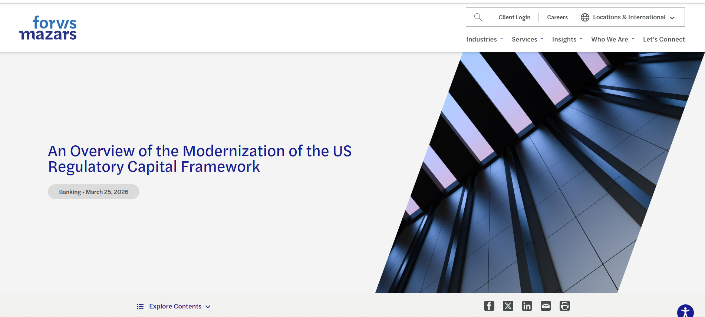
Notes:
An Overview of the Modernization of the US Regulatory Capital Framework | Forvis Mazars US

Slide 15
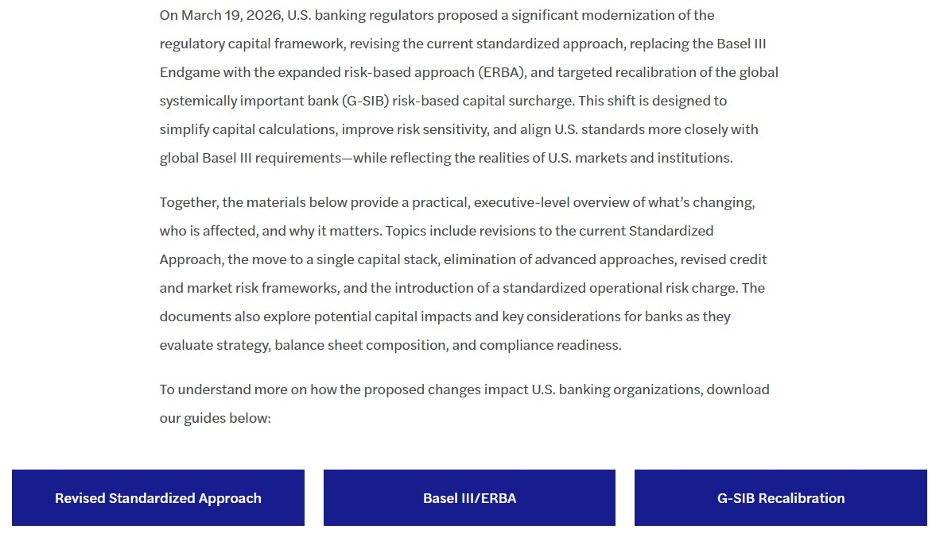

Slide 16
Compliance Conversations
ProBank Education Services
The NCUA Requests Comments on Proposal to Implement GENIUS Act – Comment Period Closes April 13, 2026.
The National Credit Union Administration is seeking comment on proposed regulations to implement portions of the Guiding and Establishing National Innovation for U.S. Stablecoins Act (GENIUS Act). The GENIUS Act charges the NCUA with licensing, regulating, and supervising payment stablecoin issuers that are subsidiaries of federally insured credit unions.
The proposed rule proposes regulations to implement the statutorily required process for approval and licensure of permitted payment stablecoin issuers (PPSIs) subject to the NCUA jurisdiction. It also proposes regulations limiting FICUs to investing in NCUA-licensed PPSIs.
91 FR 6531 – 6552 (02/12/2026)

Slide 17
Compliance Conversations
ProBank Education Services
The OCC Requests Comments on Proposal to Implement GENIUS Act – Comment Period Closes May 01, 2026.
The Office of the Comptroller of the Currency proposes to issue regulations to implement the Guiding and Establishing National Innovation for U.S. Stablecoins (GENIUS) Act regarding the issuance of payment stablecoins and certain related activities by entities subject to the OCC’s jurisdiction.
The proposed rule addresses all the regulations the OCC is required to promulgate under the GENIUS other than those related to the Bank Secrecy Act, Anti-Money Laundering, and Office of Foreign Asset Control sanctions, which will be addressed in a separate rulemaking in coordination with the Department of Treasury.
91 FR 10202 –10303 (03/02/2026)

Slide 18
Compliance Conversations
ProBank Education Services
The FDIC Requests Comments on Proposal to Implement GENIUS Act – Comment Period Extended to 05/18/26.
The Federal Deposit Insurance Corporation (FDIC) is soliciting comments on a proposal that would establish procedures to be followed by an insured State nonmember bank or State savings association that seeks to obtain FDIC approval to issue payment stablecoins through a subsidiary pursuant to the Guiding and Establishing National Innovation for U.S. Stablecoins (GENIUS) Act.
The proposed rule would establish a tailored application process for an FDIC-supervised institution to obtain approval from the FDIC to issue payment stablecoins through a subsidiary. The FDIC seeks to evaluate the safety and soundness of an applicant’s proposed activities based on consideration of statutory factors and support the responsible growth and use of digital assets and related technologies while minimizing the regulatory burden on applicants.
90 FR 59409 – 59418 (12/19/2025)

Slide 19
Compliance Conversations
ProBank Education Services
The FDIC Requests Comments on Proposal to Implement Certain Requirements pursuant to the GENIUS Act – Comment Period Closes 06/09/26.
The Federal Deposit Insurance Corporation (FDIC) is soliciting comments on a proposal that would implement certain requirements pursuant to the Guiding and Establishing National Innovation for U.S. Stablecoins (GENIUS) Act applicable to FDIC-supervised permitted payment stablecoin issuers (PPSIs) and insured depository institutions.
The proposed rule would also clarify deposit insurance coverage for deposits held as reserve assets for payment stablecoins, and clarify the treatment of tokenized deposits.
91 FR 18534 – 18579 (04/10/2026)

Slide 20
Compliance Conversations
ProBank Education Services
FinCEN & OFAC are jointly issuing a proposed rule to implement provisions of the Guiding and Establishing National Innovation for U.S. Stablecoins Act (GENIUS Act). Comment Period Closes June 09, 2026.
Specifically, this proposal implements the GENIUS Act’s directive to treat permitted payment stablecoin issuers (PPSIs) as financial institutions for purposes of the Bank Secrecy Act.
The proposed rule proposed anti-money laundering obligations for PPSIs, and proposes certain specific obligations required by the GENIUS Act for PPSIs. It also implements the GENIUS Act’s directive to require PPSIs to maintain effective (OFAC) sanctions compliance programs.
91 FR 18582 –18667 (04/10/2026)

Slide 21
Compliance Conversations
ProBank Education Services
The IRS Has Issued Proposed Regulations Relating to Trump Accounts – Comment Period Closes May 08, 2026.
The IRS has issued proposed regulations to provide guidance on making an election to open a Trump account and reserve additional sections for further guidance on Trump accounts.
The proposed regulations would affect children eligible to have a Trump account, individuals who would make elections with respect to those children, and trustees of Trump accounts. (An eligible individual is any individual who has not attained age 18 before the close of the calendar year in which an election to open an initial Trump account is made, for whom a Social Security number has been issued before the date on which the election is made, and for whom an election is made).
91 FR 11194 – 11203 (03/09/2026)

Slide 22

Compliance Conversations
Polling Questions
Which conferences would you be interested in attending?
Regulatory Compliance Conference
AML/CFT (BSA) and Fraud Compliance Conference
All of the above
None of the above

Slide 23
Compliance Conversations
ProBank Education Services
BSA/AML and Financial Crime Trends
2025 SAR “Stats”
FinCEN Advisory Health Care Fraud Schemes Targeting Medicare, Medicaid, & State Health Care
FinCEN Notice
Financially Motivated Sextortion
New Section 311 “designee” –
MBaer
2026
NMLRA, NTFRA, NPFRA
Latest FATF listing of “jurisdictions under Increased Monitoring
(e.g., the “grey list”)
Treasury Whistleblower Program

Slide 24
2025 SAR Activity Distribution
2,193,294 // 4,105,504 (+ 7.66 % // + 7.99%)
1 | Suspicion Concerning the Source of Funds | 579,229 | 9.08%
2 | Transaction with No Apparent Economic, Business, or Lawful Purpose | 576,401 | 9.04%
3 | Transaction(s) Below CTR Threshold | 551,420 | 8.65%
4 | Suspicious EFT/Wire Transfers | 519,416 | 8.15%
5 | Check | 475,878 | 7.46%
6 | Transaction Out of Pattern for Customer(s) | 379,350 | 5.95%
7 | Suspicious Use of Multiple Transaction Locations | 377,914 | 5.93%
8 | Credit/Debit Card | 316,786 | 4.97%
9 | Other Fraud (Type) | 255,279 | 4.00%
10 | ACH | 221,854 | 3.48%
11 | Identity Theft | 215,199 | 3.38%
12 | Suspicious Use of Multiple Accounts | 207,312 | 3.25%
24

Slide 25
2025 SAR Activity Distribution
2,193,294 // 4,105,504 (+ 7.66 % // + 7.99%)
13 | Counterfeit Instrument | 194,010 | 3.04%
14 | Two or More Individuals Working Together | 151,779 | 2.38%
15 | Elder Financial Exploitation | 137,713 | 2.16%
16 | Wire | 130,383 | 2.04%
17 | Other Other Suspicious Activities | 126,939 | 1.99%
18 | Suspicious Use of Noncash Monetary Instruments | 104,030 | 1.63%
19 | Account Takeover | 88,785 | 1.39%
20 | Provided Questionable or False Documentation | 86,778 | 1.36%
21 | Consumer Loan | 84,362 | 1.32%
22 | Other Money Laundering | 80,032 | 1.26%
23 | Forgeries | 77,641 | 1.22%
24 | Transaction(s) Involving Foreign High-Risk Jurisdiction | 59,972 | 0.94%
25

Slide 26
2025 SAR Activity Distribution
2,193,294 // 4,105,504 (+ 7.66 % // + 7.99%)
25 | Mass-Marketing | 43,423 | 0.68%
26 | Funnel Account | 37,437 | 0.59%
27 | Against Financial Institution Customer(s) | 30,874 | 0.48%
28 | Alters or Cancels Transaction to Avoid CTR Requirement | 26,452 | 0.41%
29 | Transaction(s) Below BSA Record-Keeping Threshold | 23,492 | 0.37%
30 | Provided Questionable or False Identification | 22,626 | 0.35%
31 | Mail | 16,858 | 0.26%
32 | Suspicious Receipt of Government Payments/Benefits | 14,611 | 0.23%
33 | Refused or Avoided Request for Documentation | 12,364 | 0.19%
34 | Embezzlement/Theft/Disappearance of Funds | 11,849 | 0.19%
35 | Little or No Concern for Product Performance Penalties, Fees, or Tax Consequences | 10,206 | 0.16%
36 | Suspicious Inquiry by Customer Regarding Bsa Reporting or Record-Keeping Requirements | 9,471 | 0.15%
26

Slide 27
2025 SAR Activity Distribution – (through 02/19/26)
2,193,294 // 4,105,504 (+ 7.66 % // + 7.99%)
37 | Against Financial Institution(s) | 8,518 | 0.13%
39 | Other Cyber Event | 7,722 | 0.12%
44 | Business Loan | 5,709 | 0.09%
50 | Unlicensed or Unregistered MSB | 3,992 | 0.06%
52 | Human Trafficking | 3,757 | 0.06%
53 | Healthcare/Public or Private Health Insurance | 3,561 | 0.06%
62 | Ponzi Scheme | 822 | 0.01%
65 | Known or Suspected Terrorist/Terrorist Organization | 361 | 0.01%
68 | Suspected Public/Private Corruption (Domestic) | 324 | 0.01%
69 | Human Smuggling | 318 | 0.00%
72 | Suspected Public/Private Corruption (Foreign) | 291 | 0.00%
73 | Other Terrorist | 224 | 0.00%
27

Slide 28
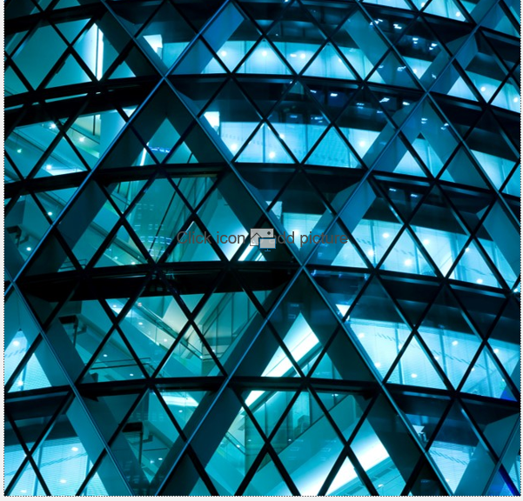
2025 SAR Distribution by State
1 | California | 331,295
2 | North Carolina | 263,173
3 | Ohio | 208,484
4 | New York | 200,182
5 | Texas | 165,893
6 | Virginia | 162,339
7 | Florida | 146,073
8 | Utah | 128,667
9 | South Dakota | 97,430
10 | Delaware | 94,759
11 | Illinois | 81,110
12 | New Jersey | 67,297
13 | Georgia | 58,331
14 | Pennsylvania | 54,356
15 | Washington | 40,885
16 | Michigan | 40,772
17 | Alabama | 38,475
18 | Tennessee | 36,084
19 | Massachusetts | 35,114
20 | Maryland | 30,980

Slide 29
2025 SAR Distribution by State
21 | Arizona | 30,592
22 | Oklahoma | 28,938
23 | Indiana | 26,340
24 | Minnesota | 24,165
25 | Puerto Rico | 23,023
26 | Wisconsin | 22,994
27 | Missouri | 21,912
28 | Nevada | 21,484
29 | South Carolina | 20,975
30 | Colorado | 20,837
31 | Connecticut | 17,380
32 | Louisiana | 16,594
33 | Oregon | 15,366
34 | Mississippi | 15,114
35 | Kentucky | 14,081
36 | Arkansas | 11,465
37 | North Dakota | 10,599
38 | Rhode Island | 10,315
39 | Kansas | 9,826
40 | Nebraska | 9,743

Slide 30
2025 SAR Distribution by State
41 | Iowa | 9,226
42 | Hawaii | 8,653
43 | New Mexico | 8,465
45 | West Virginia | 6,504
46 | Maine | 6,245
47 | District of Columbia | 5,041
48 | New Hampshire | 4,919
49 | Idaho | 4,500
50 | Montana | 4,255
51 | Alaska | 4,179
52 | Vermont | 1,891
53 | Wyoming | 1,603
54 | Unknown | 1,410
55 | Guam | 813
56 | Virgin Islands | 787
57 | APO / DPO / FPO | 420
58 | Northern Mariana Islands | 80
59 | Palau | 36
60 | American Samoa | 11
61 | Micronesia, Federated States | 9

Slide 31
2025 SAR Activity Distribution
“Top 55” Metropolitan Filing Areas (out of 1,000+)
1 | Charlotte-Gastonia-Rock Hill, NC-SC Metro Area | 229,687
2 | New York-Northern New Jersey-Long Island, NY-NJ-PA Metro Area | 219,231
3 | Washington-Arlington-Alexandria, DC-VA-MD-WV Metro Area | 149,582
4 | Columbus, OH Metro Area | 127,266
5 | Los Angeles-Long Beach-Santa Ana, CA Metro Area | 120,877
6 | San Francisco-Oakland-Fremont, CA Metro Area | 117,358
7 | Salt Lake City, UT Metro Area | 95,426
8 | Sioux Falls, SD Metro Area | 94,829
9 | Philadelphia-Camden-Wilmington, PA-NJ-DE-MD Metro Area | 86,261
10 | Miami-Fort Lauderdale-Pompano Beach, FL Metro Area | 70,541
11 | Chicago-Joliet-Naperville, IL-IN-WI Metro Area | 68,025
12 | Dallas-Fort Worth-Arlington, TX Metro Area | 48,364
13 | Houston-Sugar Land-Baytown, TX Metro Area | 44,256
14 | Atlanta-Sandy Springs-Marietta, GA Metro Area | 41,454
15 | Cincinnati-Middletown, OH-KY-IN Metro Area | 37,797
16 | Riverside-San Bernardino-Ontario, CA Metro Area | 28,097
17 | Provo-Orem, UT Metro Area | 26,687
18 | Seattle-Tacoma-Bellevue, WA Metro Area | 26,405

Slide 32
2025 SAR Activity Distribution
“Top 55” Metropolitan Filing Areas (out of 1,000+)
19 | Boston-Cambridge-Quincy, MA-NH Metro Area | 25,425
20 | Birmingham-Hoover, AL Metro Area | 24,411
21 | Phoenix-Mesa-Glendale, AZ Metro Area | 23,439
22 | Cleveland-Elyria-Mentor, OH Metro Area | 21,493
23 | Orlando-Kissimmee-Sanford, FL Metro Area | 21,370
24 | Detroit-Warren-Livonia, MI Metro Area | 20,554
25 | San Diego-Carlsbad-San Marcos, CA Metro Area | 18,923
26 | Las Vegas-Paradise, NV Metro Area | 18,245
27 | Tampa-St. Petersburg-Clearwater, FL Metro Area | 18,209
28 | Minneapolis-St. Paul-Bloomington, MN-WI Metro Area | 17,954
29 | San Juan-Caguas-Guaynabo, PR Metro Area | 16,555
30 | San Jose-Sunnyvale-Santa Clara, CA Metro Area | 15,236
31 | Baltimore-Towson, MD Metro Area | 13,997
32 | Sacramento--Arden-Arcade--Roseville, CA Metro Area | 13,249
33 | Enid, OK Micro Area | 13,028
34 | Kansas City, MO-KS Metro Area | 13,023
35 | Denver-Aurora-Broomfield, CO Metro Area | 12,683
36 | Raleigh-Cary, NC Metro Area | 11,803
37 | Buffalo-Niagara Falls, NY Metro Area | 10,916

Slide 33
2025 SAR Activity Distribution
“Top 55” Metropolitan Filing Areas (out of 1,000+)
38 | San Antonio-New Braunfels, TX Metro Area | 10,552
39 | Providence-New Bedford-Fall River, RI-MA Metro Area | 10,310
40 | Nashville-Davidson--Murfreesboro--Franklin, TN Metro Area | 9,974
41 | Austin-Round Rock-San Marcos, TX Metro Area | 9,650
42 | Memphis, TN-MS-AR Metro Area | 9,217
43 | St. Louis, MO-IL Metro Area | 8,828
44 | Portland-Vancouver-Hillsboro, OR-WA Metro Area | 8,712
45 | Richmond, VA Metro Area | 8,317
46 | Jacksonville, FL Metro Area | 8,303
47 | Pittsburgh, PA Metro Area | 8,267
48 | Fargo, ND-MN Metro Area | 7,998
49 | Indianapolis-Carmel, IN Metro Area | 7,893
50 | Virginia Beach-Norfolk-Newport News, VA-NC Metro Area | 7,699
51 | Lansing-East Lansing, MI Metro Area | 6,911
52 | Bridgeport-Stamford-Norwalk, CT Metro Area | 6,898
53 | Oklahoma City, OK Metro Area | 6,896
54 | Milwaukee-Waukesha-West Allis, WI Metro Area | 6,622
55 | Honolulu, HI Metro Area | 6,546

Slide 34
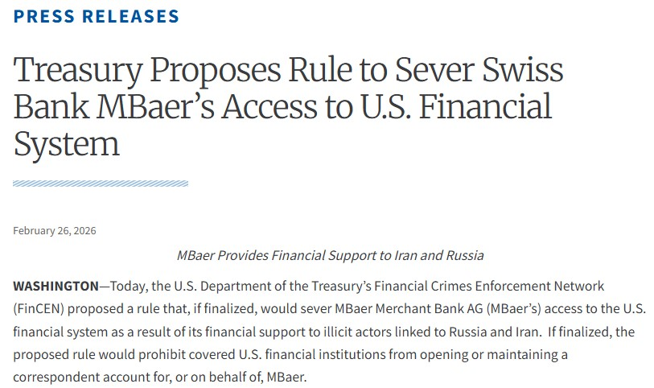
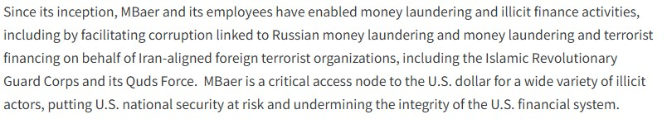
91 FR 10035 – 10048
03/02/2026
Comments Close
04/01/2026
Notes:
Treasury Proposes Rule to Sever Swiss Bank MBaer’s Access to U.S. Financial System | U.S. Department of the Treasury

Slide 35
FATF Statements / UNSCR Resolution
FATF – “High-Risk and Non-Cooperative Jurisdictions (HRNCJ). On 02/13/26 FATF publicly identified countries with remaining AML deficiencies:
Call to Action:
  Countermeasures: Democratic People’s Republic of North Korea & Iran – all jurisdictions are encouraged to follow FATF statement of 02/20/20 and Executive Orders (E.O.s) 13810, 13949, and 13876, and apply effective counter-measures to protect their financial sectors from ML/FT risks emanating from North Korea and Iran.
  EDD – Myanmar – (In 02/2020 Myanmar added to Due Diligence section – due to lack of progress and most action items were not addressed one year after the deadline – focus elevated in 10/2022).
Jurisdictions Under Increased Monitoring –
  Due Diligence / Commitments Made – Strategic Deficiencies Noted: Algeria; Angola; Bolivia; Bulgaria; Cameroon; Cote D’Ivoire; Democratic Republic of Congo (DRC); Haiti; Kenya; Kuwait; Lao PDR; Lebanon; Monaco; Namibia; Nepal; Papa New Guinea; South Sudan; Syria; Venezuela; Vietnam; Virgin Islands (UK); and Yemen.
  Commitments Satisfied – None

Slide 36
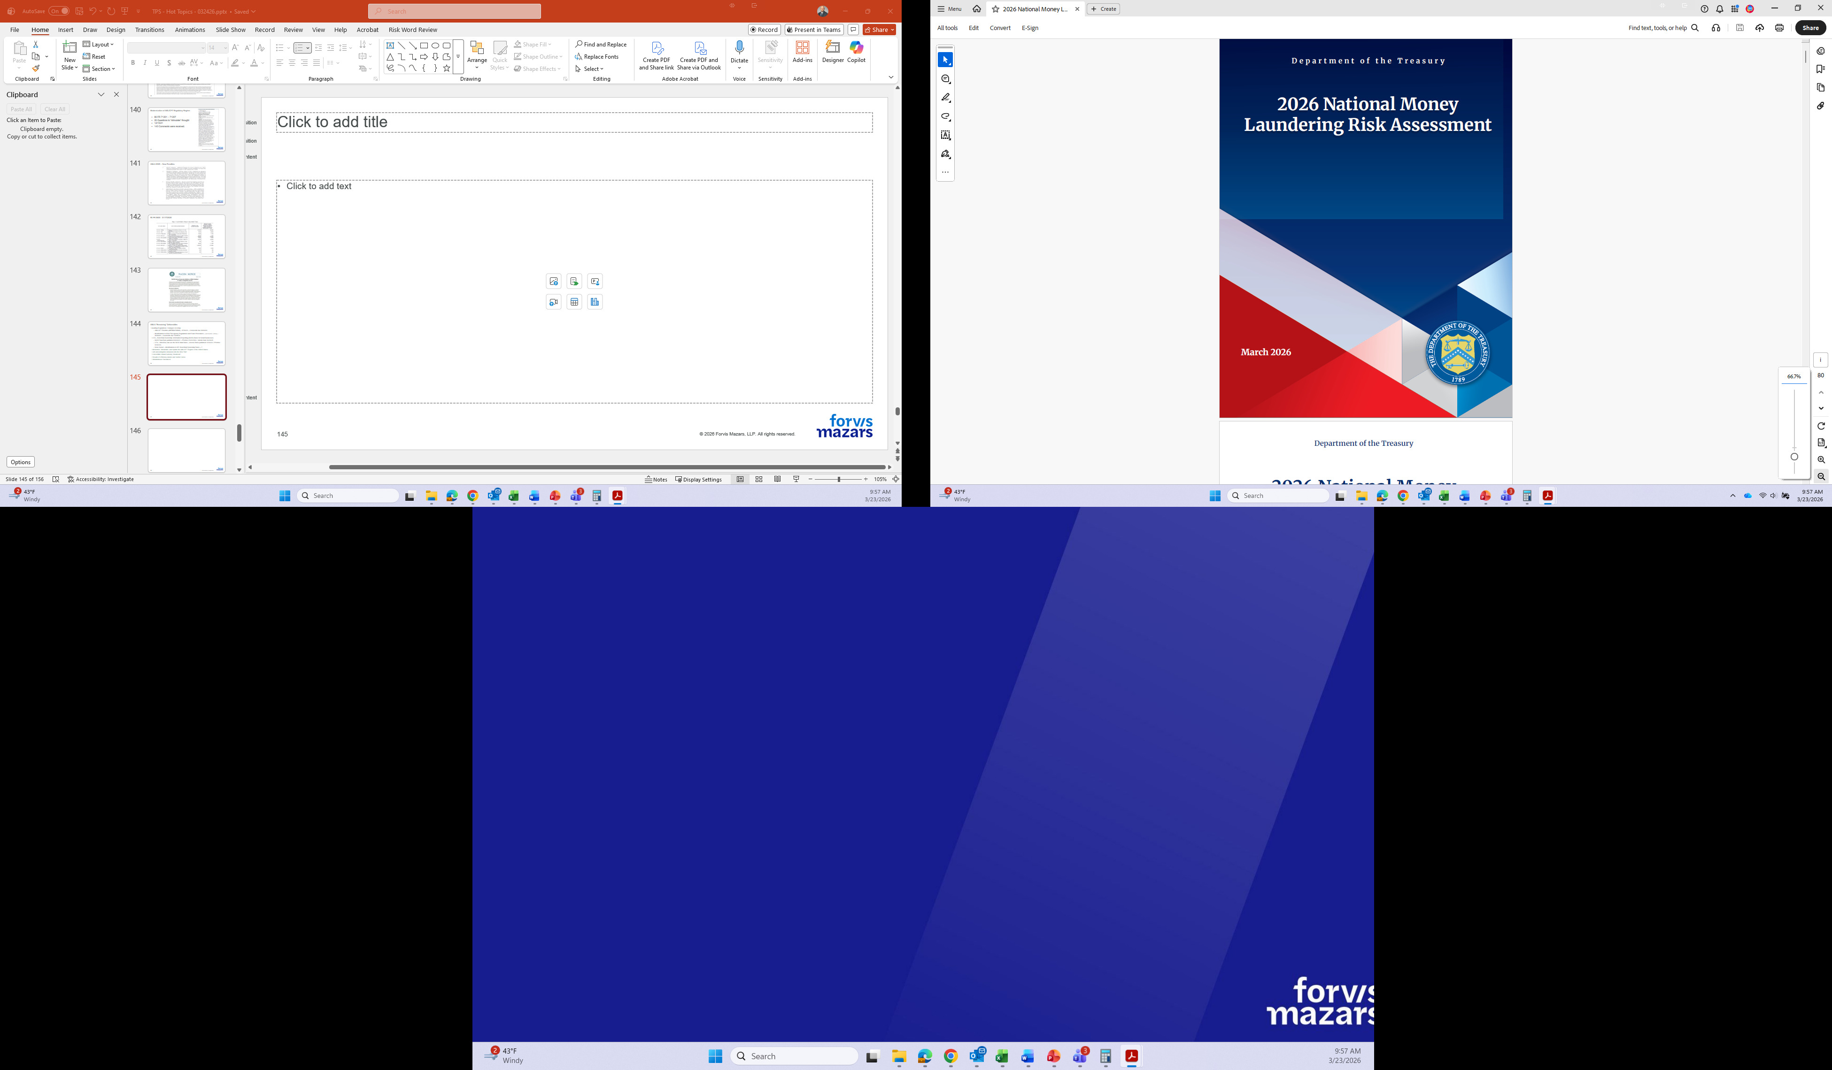
Notes:
2026 National Money Laundering Risk Assessment

Slide 37
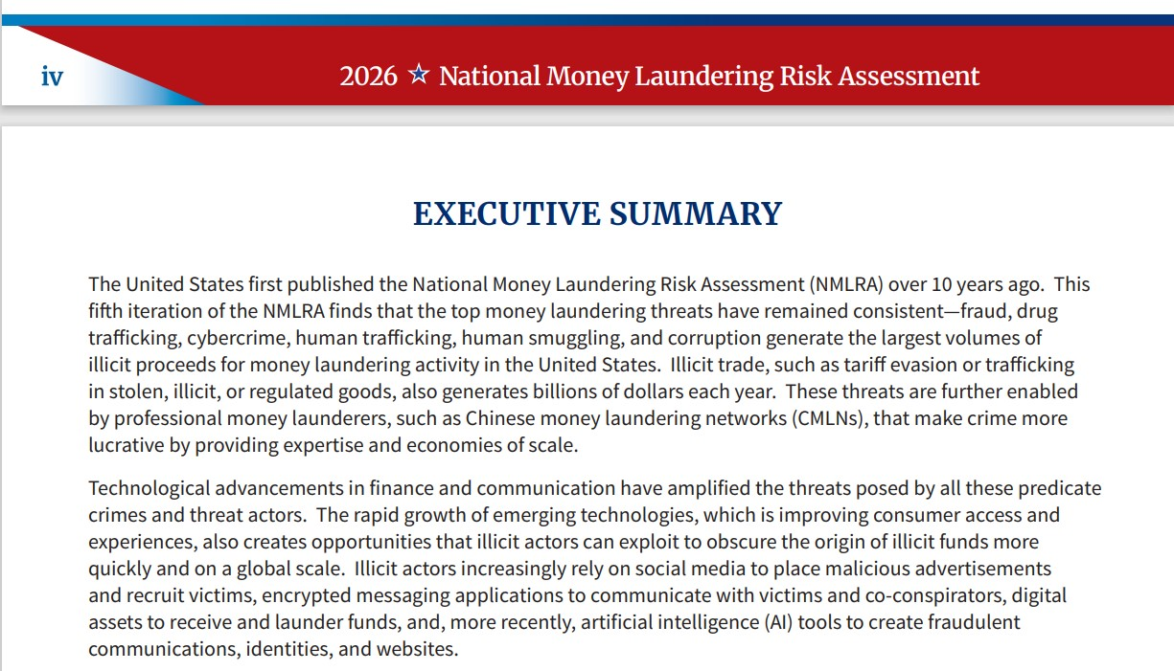
Notes:
2026 National Money Laundering Risk Assessment

Slide 38
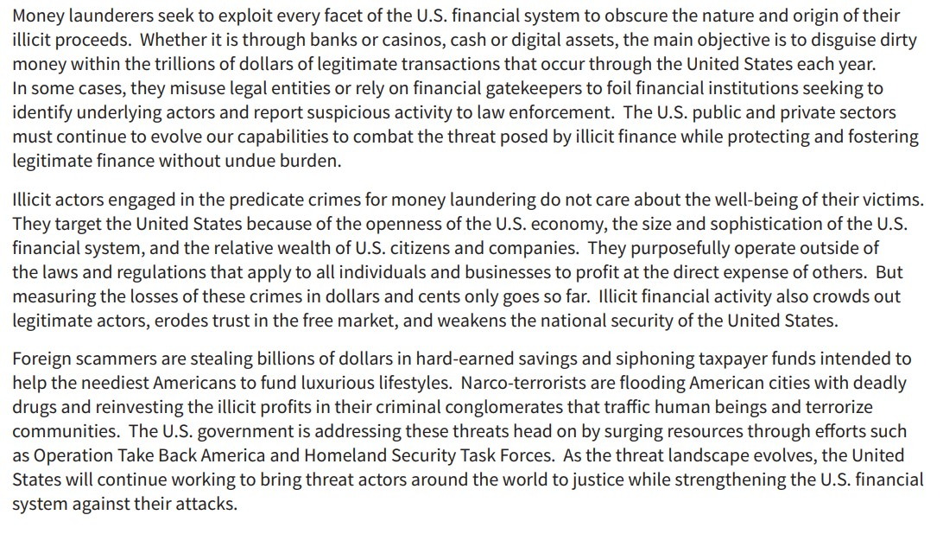
Notes:
2026 National Money Laundering Risk Assessment

Slide 39
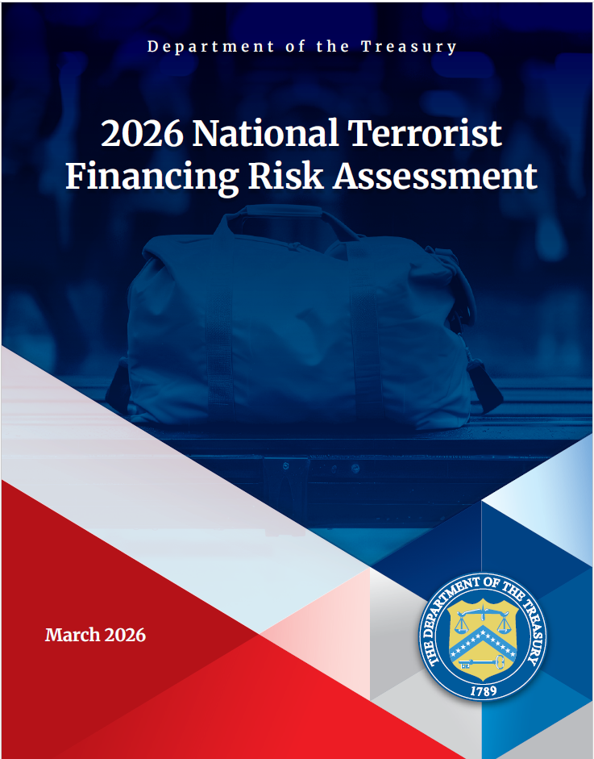
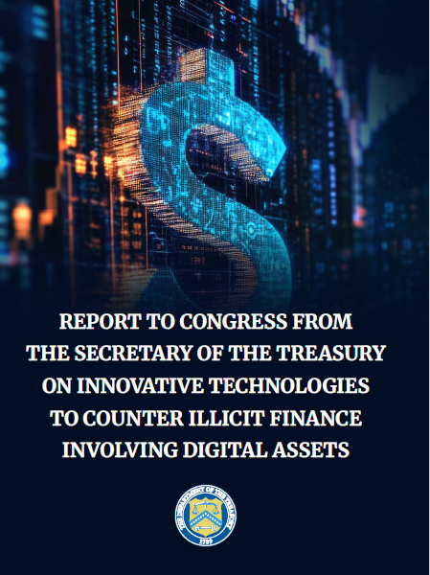


Slide 40
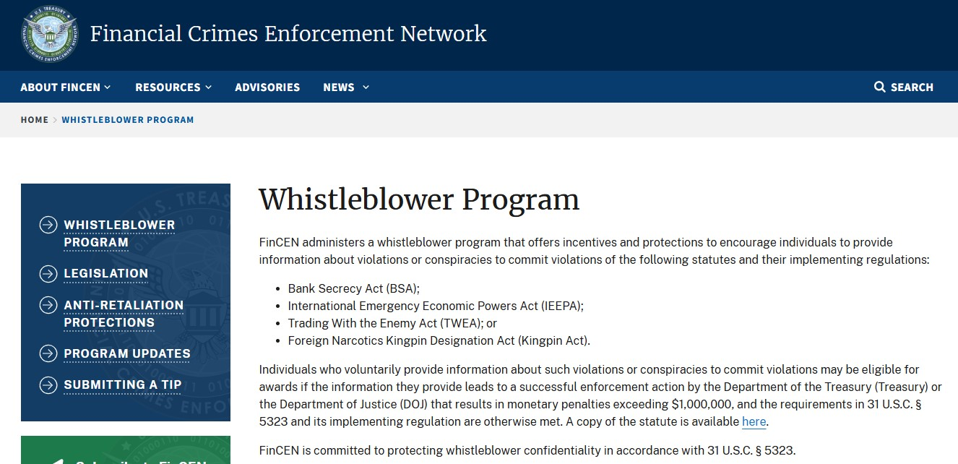
Announced 02/13/2026
Notes:
Whistleblower Program | FinCEN.gov

Slide 41
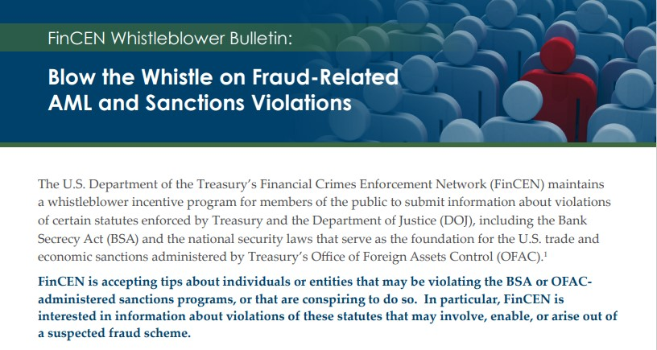
Notes:
OWB Whistleblower Bulletin

Slide 42
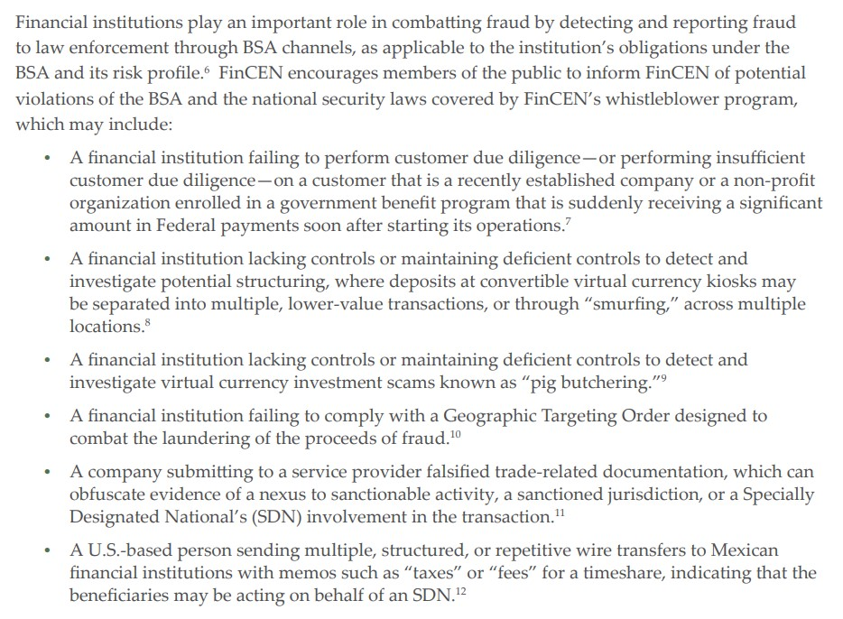
Notes:
OWB Whistleblower Bulletin

Slide 43
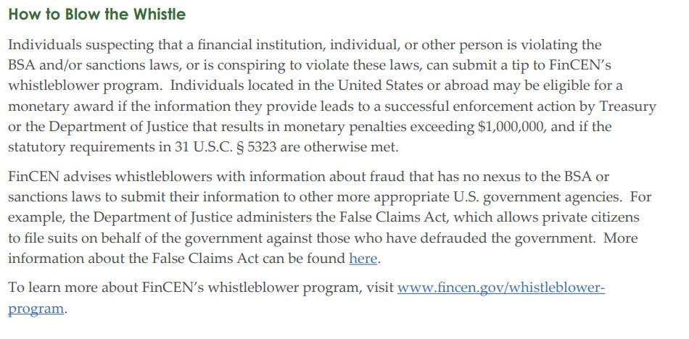
Notes:
OWB Whistleblower Bulletin

Slide 44
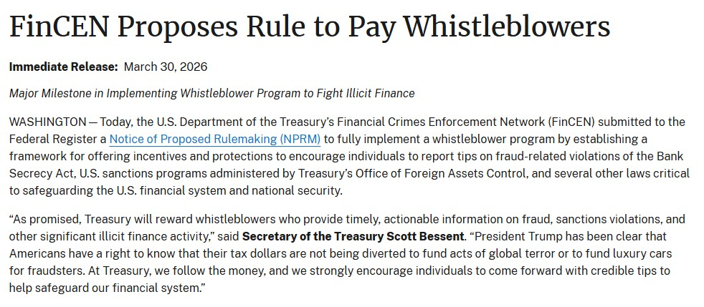
91 FR 16328 – 16386
April 01, 2026
Comments Close
June 01, 2026
Notes:
FinCEN Proposes Rule to Pay Whistleblowers | FinCEN.gov

Slide 45
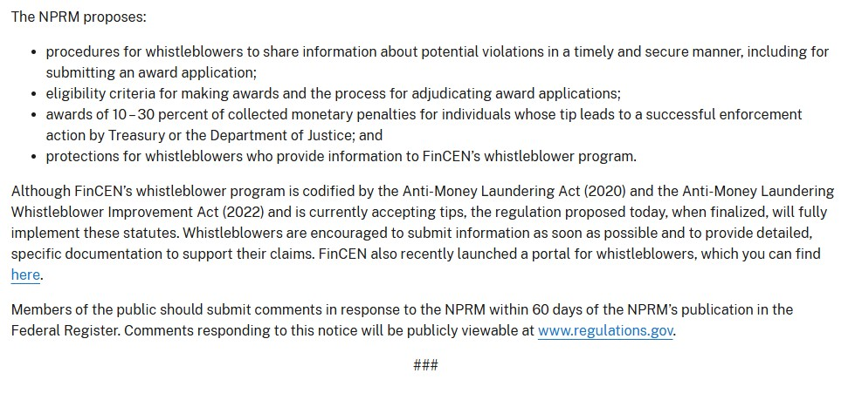
Notes:
FinCEN Proposes Rule to Pay Whistleblowers | FinCEN.gov

Slide 46
Compliance Conversations
ProBank Education Services
Payments / Fraud Trends
2025 ACH Volumes – A New Record
NACHA – Availability of Non-Same-Day Credits
NACHA – Fraud Monitoring – Phase 1
Proof of Audit Attestations
FTC “Alerts”

Slide 47
Compliance Conversations
Polling Questions
How does your institution stay up-to-date on regulations and get compliance help?
We rely on internal staff to monitor and interpret changes.
We subscribe to regulatory update services or newsletters.
We use third-party compliance tools or platforms (e.g., ProBank Advisor, etc).
We work with external consultants or legal advisors.
We’re not confident we have a reliable process in place.

Slide 48
2025 ACH Volumes
In 2025, NACHA reported volumes of 35.2 Billion Entries processed through the Network, an increase of +1.6 Billion (+ 4.9%). Total Volumes in 2024 were 33.6 Billion Entries. Network $’s processed grew $ 6.8 Trillion, (+ 7.9%) with $93.003 Trillion in value.
B2B Entries grew + 9.9%, and increased to 8.1 Billion Entries (CCD & CTX accounted for $ 63.1 trillion);
Direct Deposit increased + 1.7%, and increased from 8.63 Billion to 8.7 Billion Entries (PPD credits accounted for $ 21.038 Trillion);
WEB Entries grew + 6.1%, and increased to 11.4 Billion Entries (WEB accounted for $7.753 trillion);
P2P Entries grew + 19.8%, and increased to 470 Million Entries;
Healthcare Entries grew + 7.3% and increased to 548 Million Entries;
SDAs grew + 16.7% and totaled 1.4 Billion Entries with a value of $ 3.9 Trillion - + 21.4 % > 2024 / In 2025, SDA moved an average of 5.6 Million payments/day with a daily total average value of $ 15.6 Billion // 2025 was the second year that SDA value passed $ 3 Trillion, and the second time that volume exceeded 1 Billion Entries.

Slide 49
Compliance Conversations
ProBank Education Services
Action Items and Next Steps
Review your compliance programs for alignment with new guidance.
Submit comments on proposed rules where relevant.
Prepare for upcoming deadlines.

Slide 50
Regulation | Agency | Compliance Deadline | Summary | Status
FDIC Signage Rule – Digital Channels (Part 328) | FDIC | April 1, 2027 | Requires FDIC signage on digital platforms and ATMs. | Compliance date for Parts 328.4 & .5 extended to April 1, 2027.
Deposit Insurance Coverage for Branches of U.S. Banks in the Federated States of Micronesia, the Marshall Islands, and Palau | FDIC | April 22, 2026 | FDIC will insure deposits of all branches of U.S.-insured depository institutions (IDIs) in the Federated States of Micronesia, the Republic of the Marshall Islands, and the Republic of Palau. | Final Rule – Interim Rule with a Request for Comments was issued in August 2024.
Small Business Lending Data Collection (Section 1071, Reg B) | CFPB | July 1, 2026 (Tier 1) | Requires large lenders to collect/report small business loan data. | Enforcement paused. CFPB stated it will not enforce until rule is rewritten.
 |  | January 1, 2027 (Tier 2) | Moderate-volume lenders begin data collection. | Same as above.
 |  | October 1, 2027 (Tier 3) | Smallest lenders begin data collection. | Same as above.

Slide 51
Compliance Conversations
Polling Questions
Would you be interested in learning more about ProBank Education Services training services & programs?
Yes
Not right now

Slide 52
Thank you for participating in our discussion today!
Questions?

Slide 53
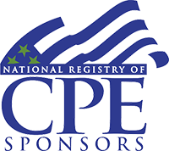

CPE CREDIT
CPE credit may be awarded upon verification of participant attendance
For questions, concerns, or comments regarding CPE credit, please email FORVIS at cpecompliance@us.forvismazars.com
Forvis Mazars, LLP is registered with the National Association of State Boards of Accountancy (NASBA) as a sponsor of continuing professional education on the National Registry of CPE Sponsors. State boards of accountancy have final authority on the acceptance of individual courses for CPE credit. Complaints regarding registered sponsors may be submitted to the National Registry of CPE Sponsors through its website: www.nasbaregistry.org

Slide 54
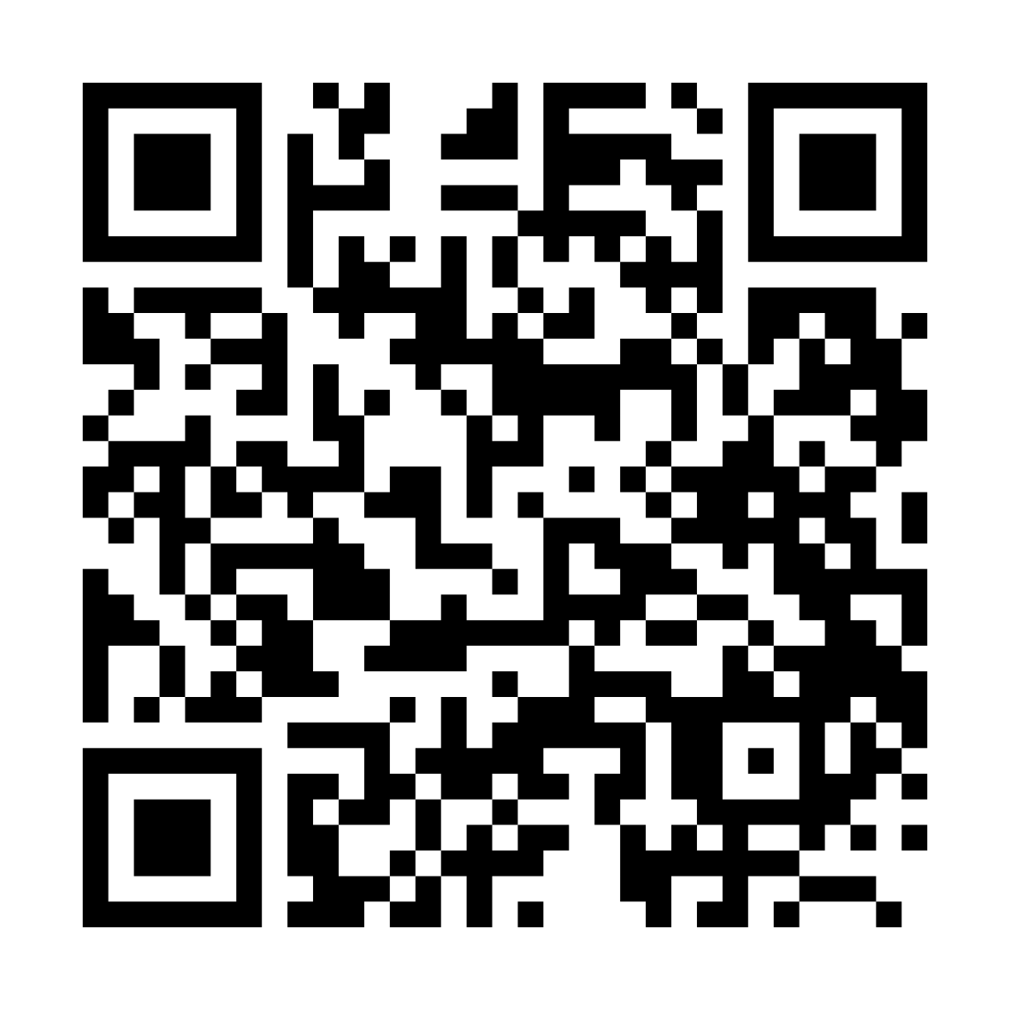

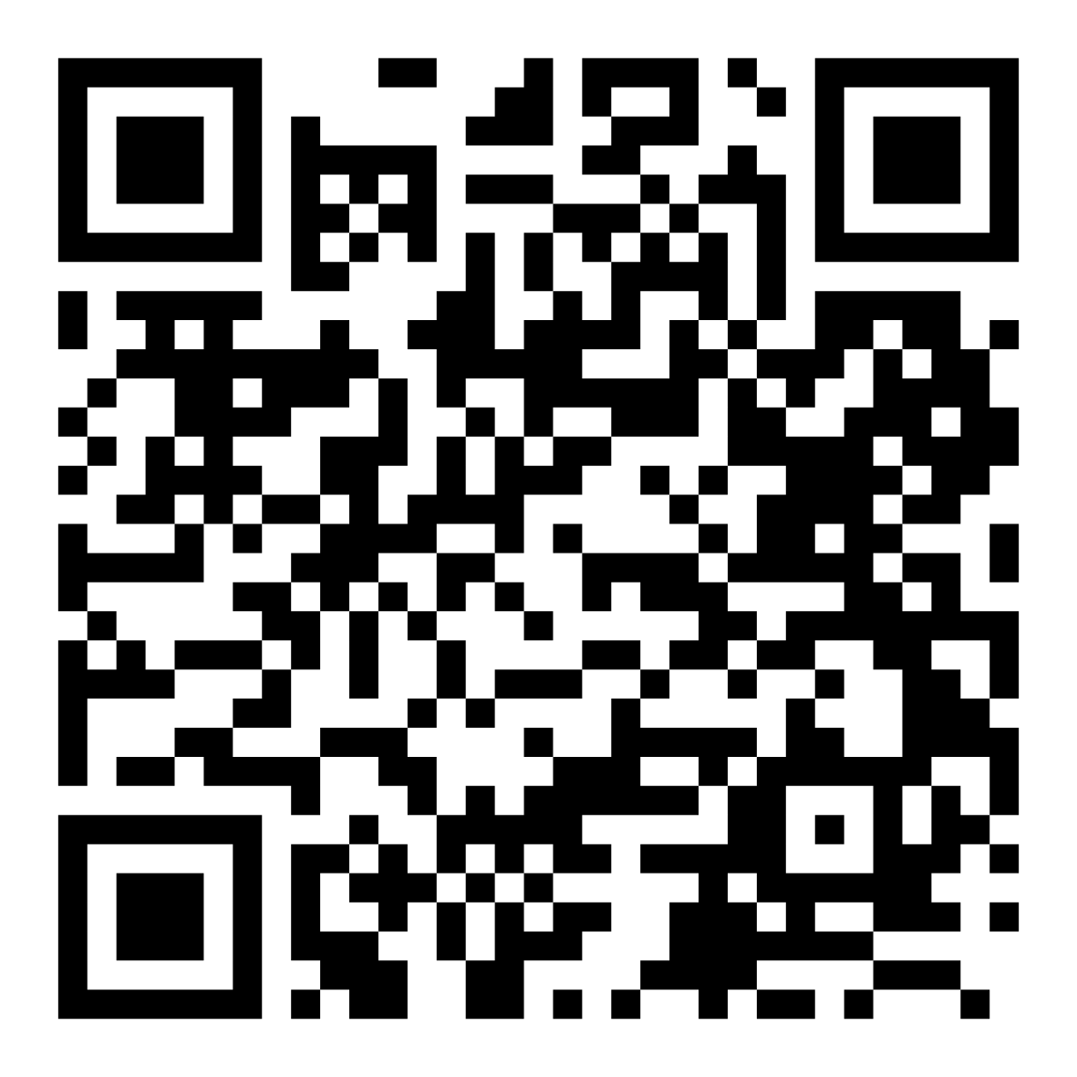
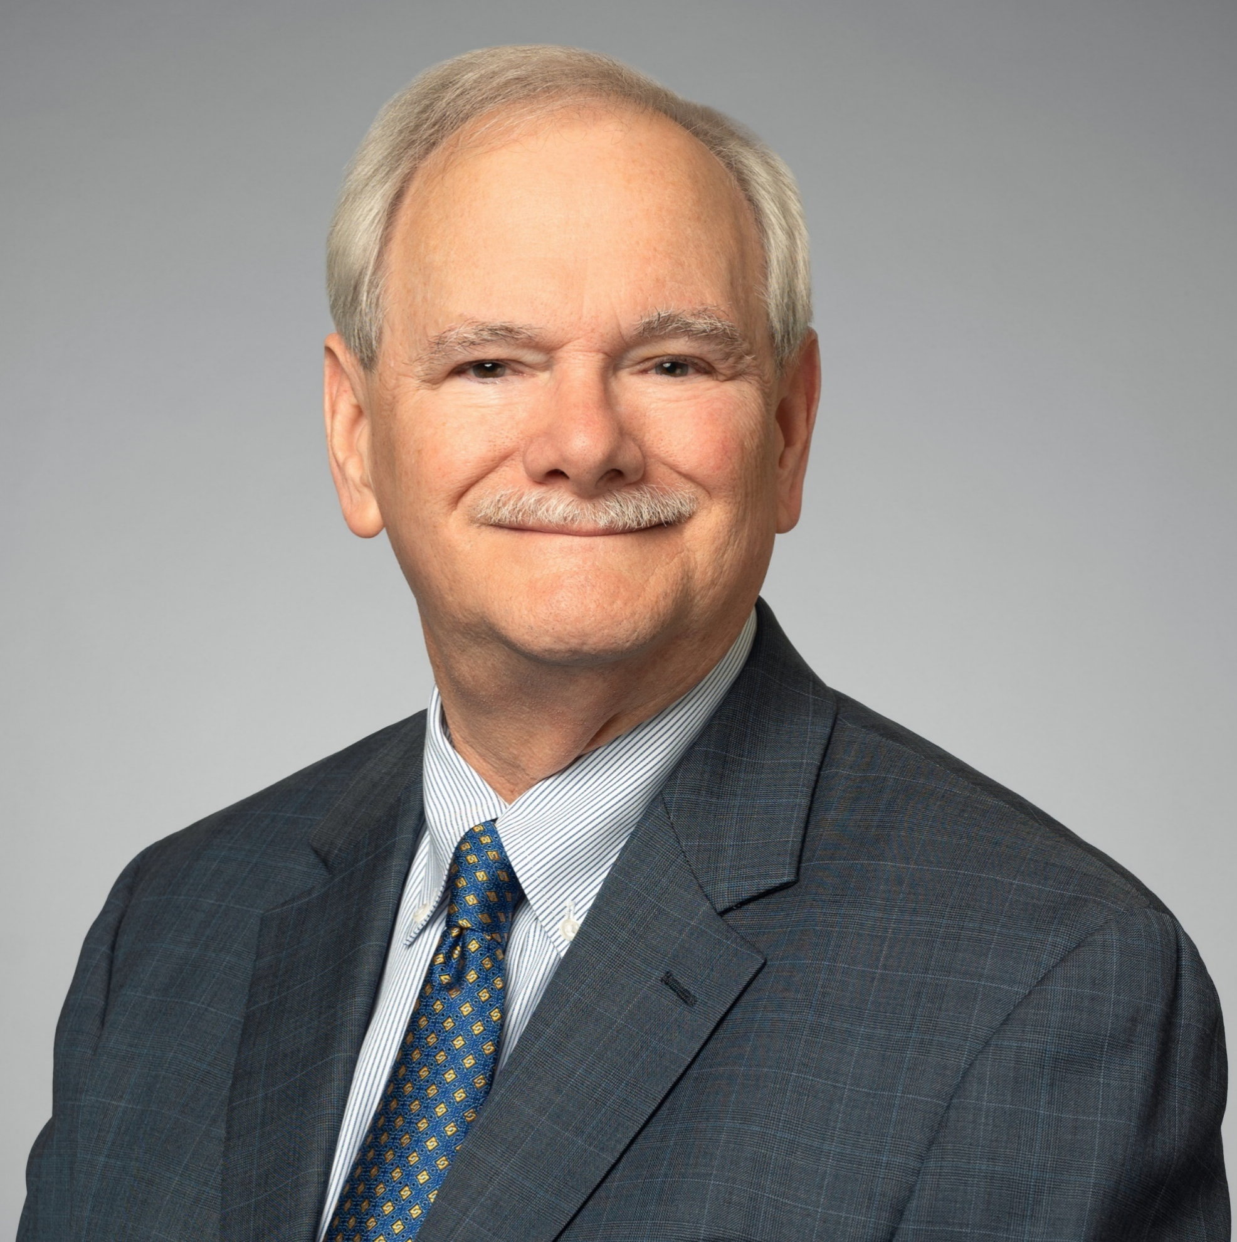
Let’s stay in touch!
Scan the QR code to connect with me on LinkedIn.
Mark Burnside
Director
Mark Dever
Director

Slide 55








ProBank Education Services
As a leading provider of continuing education programs for financial professionals, we train thousands of financial industry employees annually through our tailored programs. Our services are available throughout the United States or virtually and include compliance seminars, webinars, and in-house training courses specifically designed for accountants, branch managers, BSA officers, compliance officers, customer service, executive management, loan processors, mortgage brokers, new accounts personnel, operations officers, risk management, and directors.
Seminars
ProBank Education Services provides a wide range of bank regulatory compliance seminars throughout the United States – whether In-Person (On-Site) or Remote (Virtual) – choose what is best for you.
Speakers Bureau
One of our most valued educational assignments is to serve as instructors at schools, conferences, and conventions across the United States. Our well-received presentations rely on the depth of experience of our team and are designed to help sharpen attendees’ regulatory compliance acumen and banking skills. We customize each presentation to meet the needs of a specific audience which ranges from basic to intermediate to advanced levels of information on compliance topics.
Webinars
ProBank Education Services provides insightful and engaging webinars in a format that is right for you and your employees, including Live and On-Demand options.
In-House Training
Our educational programs and professional instructors are available to come to you. Each year, we work with financial institutions who request educational programs on-site at their institution for their employees. These programs provide the benefits of our national seminar events but are delivered with a more customized approach.
Publications – Newsletters & Manuals
We offer a wide variety of publications ranging from a quarterly newsletter to a growing list of in-depth manuals on specific topics. Our newsletter, InCompliance™, helps keep you informed about recent regulatory pronouncements and current issues, and provides helpful compliance and management tips.
Compliance Schools & Conferences
ProBank Education Services personnel routinely serve as instructors at banking schools and conferences across the United States. Because of the breadth of our experience, we can adjust our presentations to fit the needs of the specific audience at the basic, intermediate, or advanced level. In addition, we provide regional regulatory compliance conferences throughout the year.
ProBank Advisor©
ProBank Advisor© is a compliance advisory service that can offer you the compliance advice you need. Connecting with an experienced compliance professional is simple through ProBank Advisor’s easy-to-navigate platform.
Association-Sponsored Seminars
For many years, ProBank Education Services has presented programs under the auspices of many state, community, and independent banker associations, credit union leagues and other industry groups on specific areas of interest, such as compliance, deposits, lending, AML/BSA, fair lending, CRA, compliance risk management and more. These programs are presented on a “turn-key” basis.
Tammy Carter | Managing Director | 502.479.5229 | tammy.carter@us.forvismazars.com | probank.com
Notes:
Add tech Compliance

Slide 56


Upcoming Conferences: Save the Dates!

Slide 57
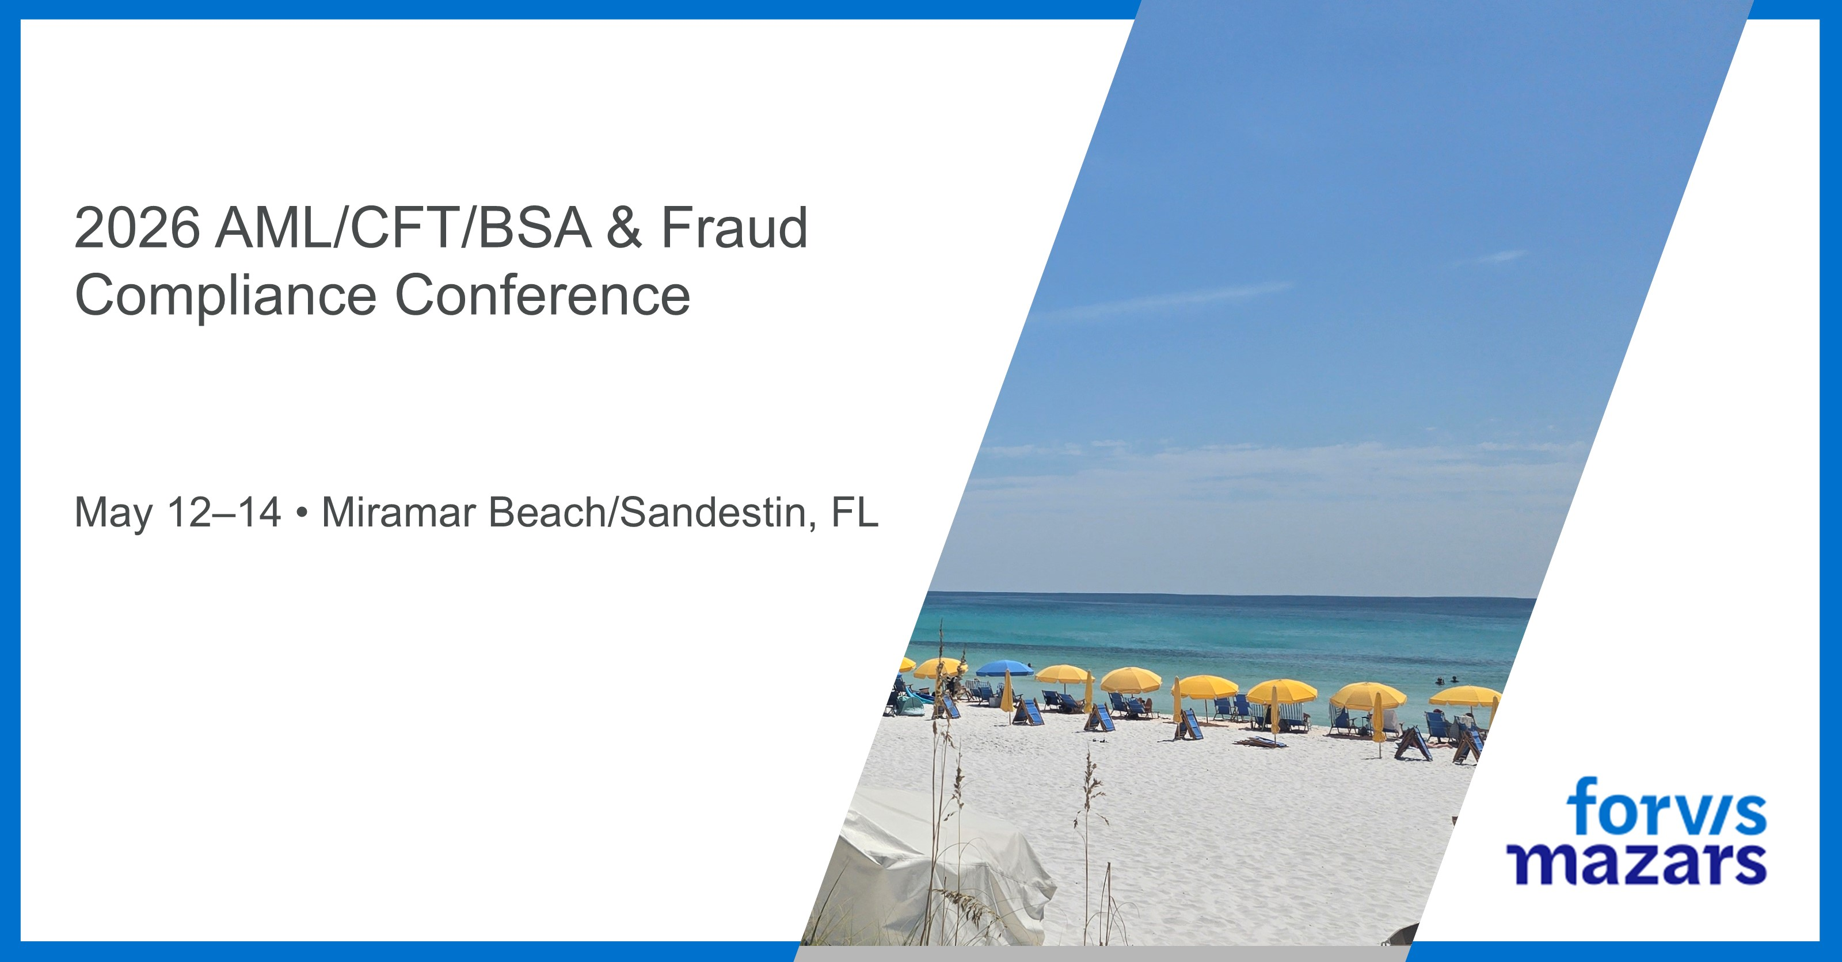
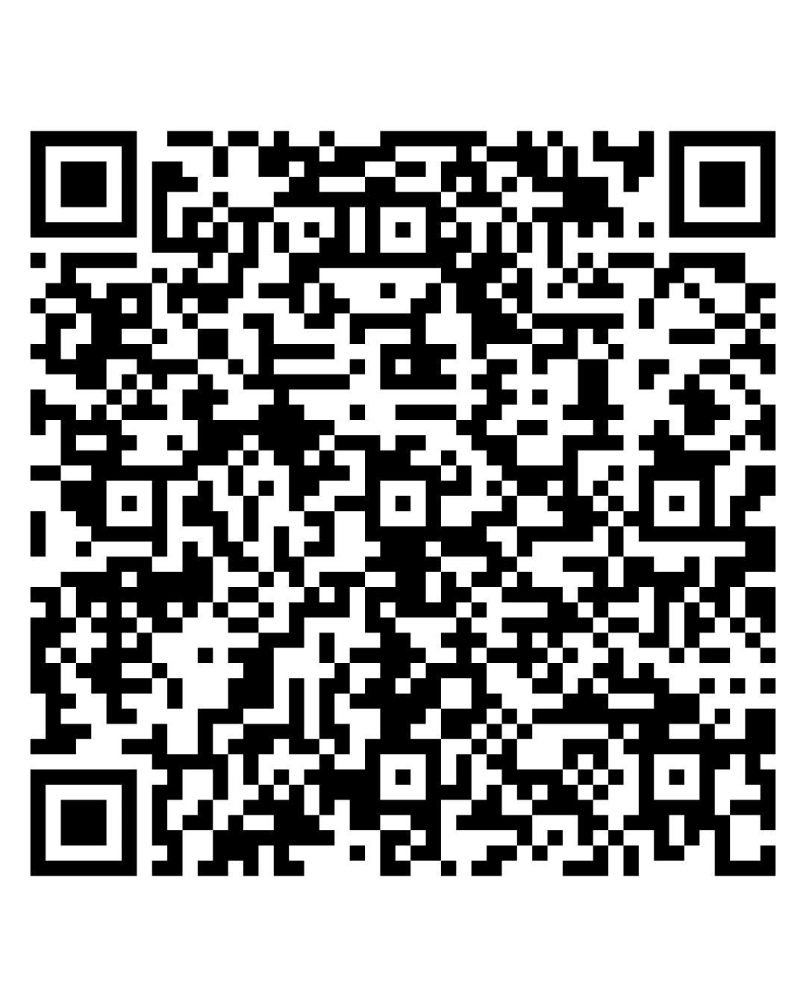
Save Your Spot

Slide 58
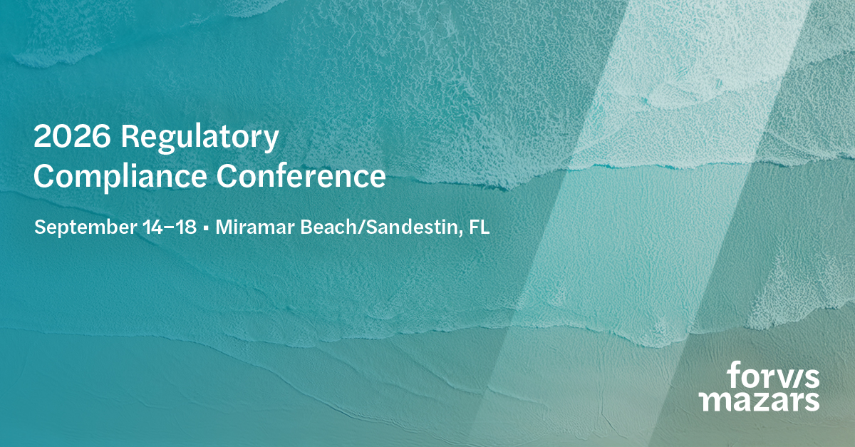
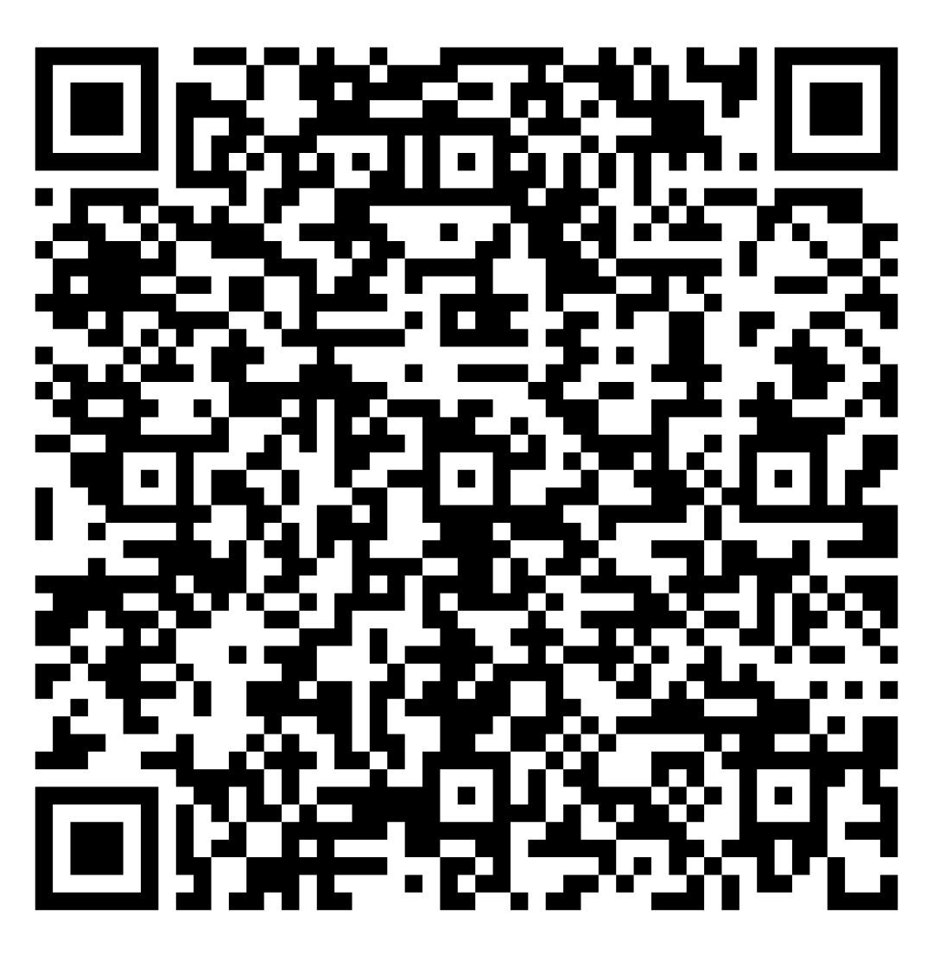
Register Today

Slide 59
