Slide 1


2023 Nonprofit &
Public Sector
Seminar

Slide 2
Kansas City Chiefs: Finance, Strategy and Analytics Michael Ragsdale

Slide 3


Finance, Strategy and Analytics
Purpose: Move the organization forward by providing real-time insights, predictive results and strategic guidance.
Financial Analytics
Business Analytics
Revenue Generation (Renewal and Pricing Models, Data Warehouse and CRM Implementation, Live Revenue Reporting)
New Ventures
Game Day Reporting and Insights
Marketing Analytics Buildout
Chiefs Fit Gyms
Financial Planning Consolidation and Automation
Chiefs Capital Investment Review
Investments that compliment our core business
Arrowhead Events financial planning and settlement

Slide 4
Finance Strategy and Analytics
VP of Finance Strategy & Analytics
Business Intelligence Manager
Data Science Manage
Senior Data Scientist
Business Intelligence Analyst
Data Scientist
Data Scientist
CFO
Seasonal Data Scientist

Slide 5


Finance, Strategy and Analytics
Financial Analytics
Financial Package
Rolling Forecast
Provide 12-24 months of forecasted financial information
Enhance Risk Management
Focus on aligning financials with the organization strategic goals
Local EBITDA Protection and Growth
5 year plan review
Revenue and expense break down and analysis
International Markets Structure and Growth
Visual Financial Reporting
Brand leaders for Vena to use Power BI tool
Concert Financial Planning and Event Settlement

Slide 6

Finance, Strategy and Analytics
Business Analytics
Centralize 3rd party analytics tools
Pricing models
Fan Engagement Dashboard
Marketing Insights
Partnership Asset Valuation
HR Analytics
Live Game Reporting and Insights
Data Warehousing

Slide 7

Finance, Strategy and Analytics
New Ventures
Chiefs Fit
Financial Model
Investment Analysis
Continued review

Slide 8
Super Bowl Timeline
Planning
Playoffs
Ticket allotment
Post Win
Evaluate 3rd party involvement (On-Location)
Set budget and contingency needs
Parade
November: Cross Department Committee
Establish Goals and Objectives
Schedule weekly meetings for the remainder of the season
Review NFL Policies for the Super Bowl
Establish Travel Party Size
Super Bowl LVII
Team Travel and Support
F&F Travel
Activation
Parties
NFL Draft
White House Visit
Ring Ceremony

Slide 9
Thank you!

Slide 10


Slide 11


Prepare Your Nonprofit for the Future: Accepting Crypto Donations
May 23, 2023
FORVIS is a trademark of FORVIS, LLP, registration of which is pending with the U.S. Patent and Trademark Office.

Slide 12

Meet the Presenter
Nik “Crypto Nik” Fahrer
Senior Manager / FORVIS

Slide 13
Housekeeping Items
Please ask questions
There is no such thing as a stupid question
I will try to answer as many as I can
This webinar is not financial, tax, or legal advice
Consult your advisor

Slide 14
Explore the changing landscape of generosity & why crypto donations are rising in popularity
Understand the tax & reporting considerations for accepting crypto donations
Learn how FORVIS is streamlining the process & mitigating risk for nonprofits

Slide 15

Show of Hands
Do you think the world will be more digital in 10 years than it is today?

Slide 16
Show of Hands
Raise your hand if you would say you are well versed in this topic

Slide 17
Show of Hands
Has your organization ever received a cryptocurrency donation?

Slide 18
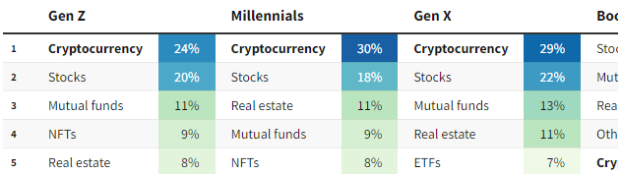
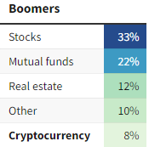
Why Should We Talk About Crypto?
Study participants were asked: where do you expect the greatest return on your investments over the next 10 years?
Generational Investment Shift
(Investopedia 2022 Financial Literacy Survey)

Slide 19










Evolution of the Internet
Web 1 | Web 2 | Web 3
Read Only | Read & Write | Read, Write, & Own
Decentralized | Centralized | Decentralized
Basic Web Pages | Social Media | AI/VR/AR/Metaverse
Desktop | Mobile | IoT Devices
1990 – 2000 | 2000s – 2020s | 2020s –

Slide 20

Blockchain
Blockchain is a fancy word for a database / digital ledger
Blockchain is a transparent, distributed, append-only, digital ledger
This Photo by Unknown Author is licensed under CC BY-SA-NC

Slide 21
What’s the difference?
Token
Cryptocurrency
Blockchain

Slide 22
Growth of Crypto
One report found that businesses can expand their customer base by up to 40% by accepting cryptocurrency
Another report found that 95% of boards are actively seeking to educate themselves on digital assets
34 million U.S. adults owned cryptocurrency at end of 2022

Slide 23
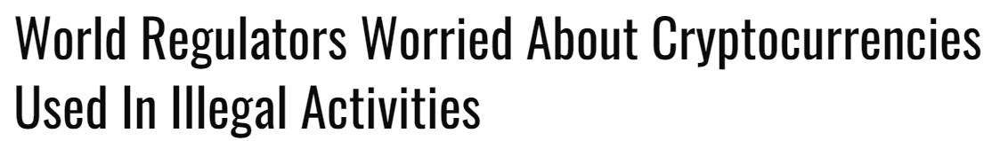

From the Outside, Crypto Can Seem Scary
Substantial learning curve
Headlines

Slide 24
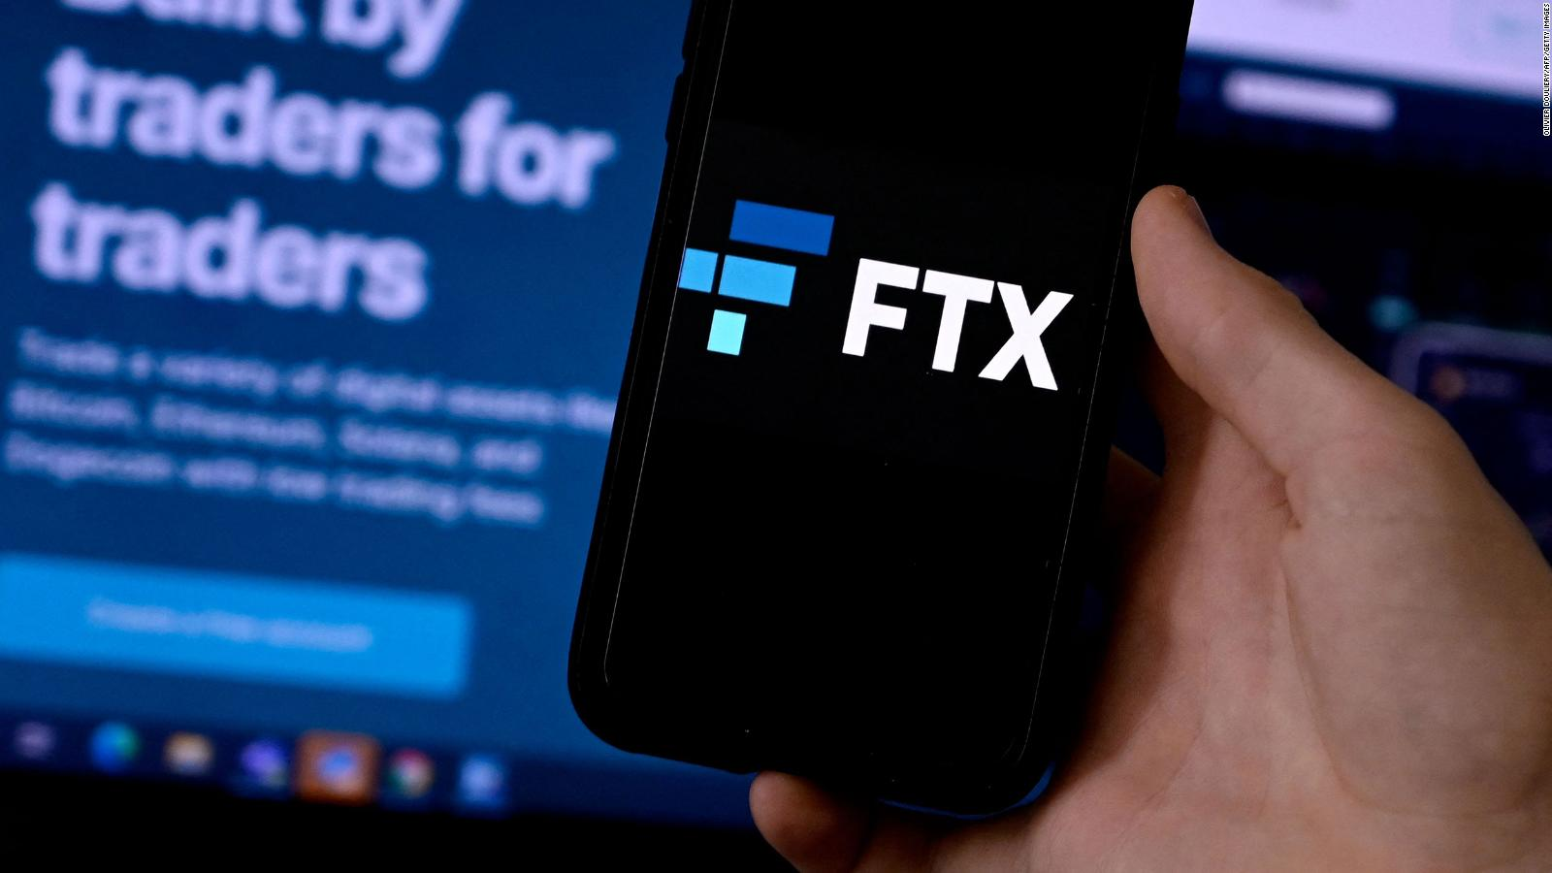
Let’s Talk About FTX
Enron
Bernie Madoff
Subprime mortgage crisis
Theranos
Traditional Banks
Silicon Valley
Signature
Silvergate
First Republic

Slide 25
Fact or Fiction? “Crypto has No Value”

Slide 26
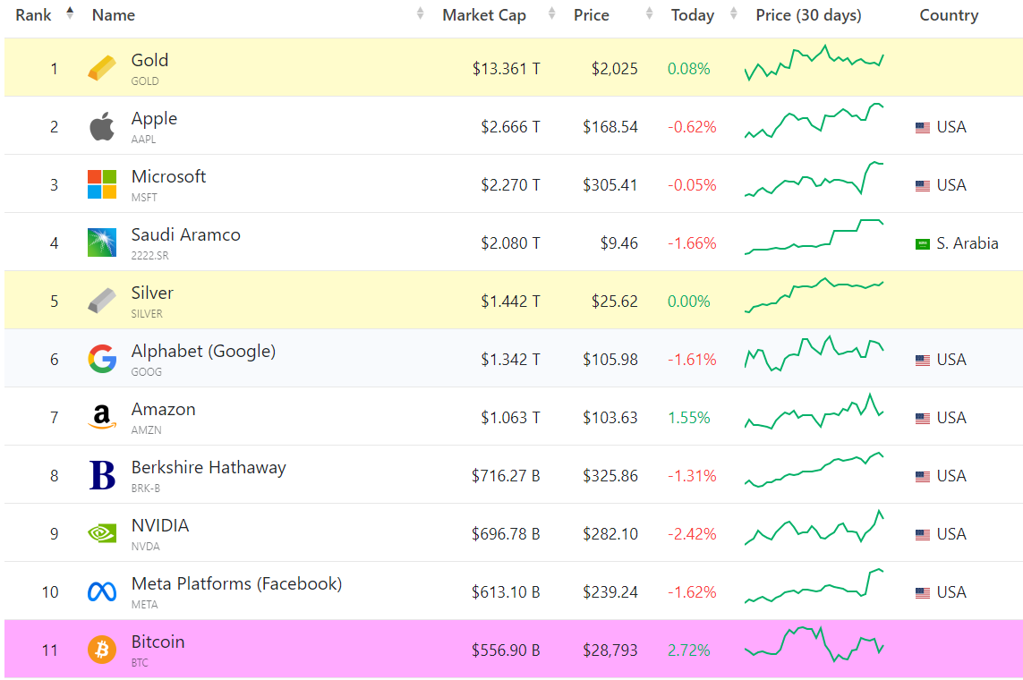
Largest Investments in the World by Market Cap

Slide 27

“Crypto Has No Value”
Peer to Peer
Borderless
Permissionless
Transparent

Slide 28
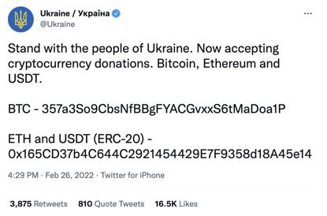
Crypto Has No Value

Slide 29
Fact or Fiction? “Crypto is too volatile and not a safe store of value”

Slide 30

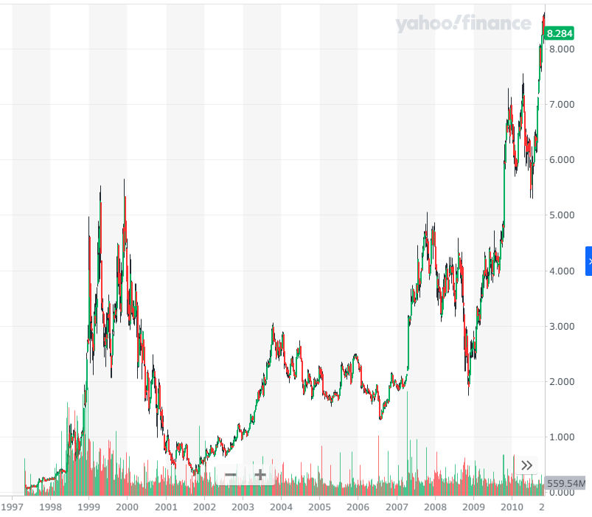
“Crypto is too volatile and not a safe store of value”

Slide 31
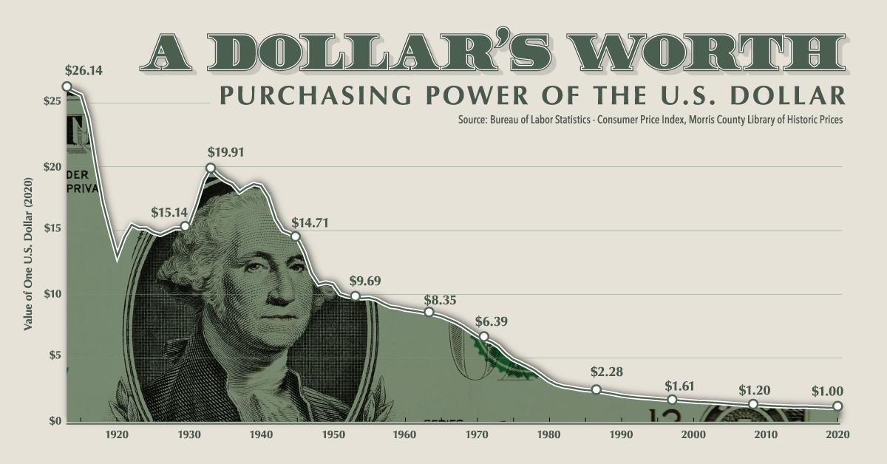
“Crypto is too volatile and not a safe store of value”

Slide 32
Fact or Fiction? Crypto is Scammy and Needs Consumer Protection

Slide 33
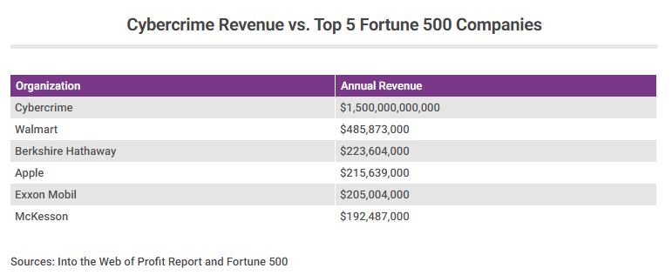
“Crypto is Scammy and Needs Consumer Protection”

Slide 34
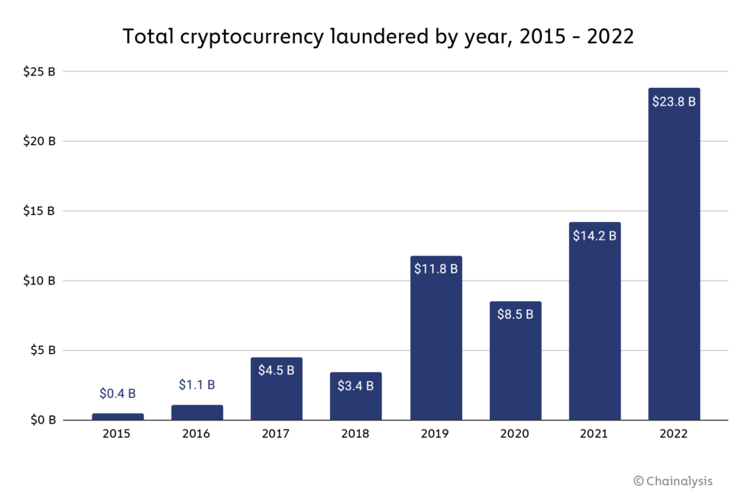
“Crypto is Scammy and Needs Consumer Protection”
1.59% of cybercrime

Slide 35
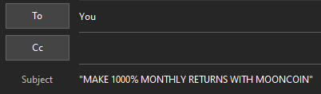
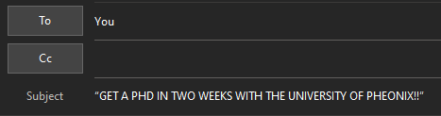
“Crypto is Scammy and Needs Consumer Protection”

Slide 36
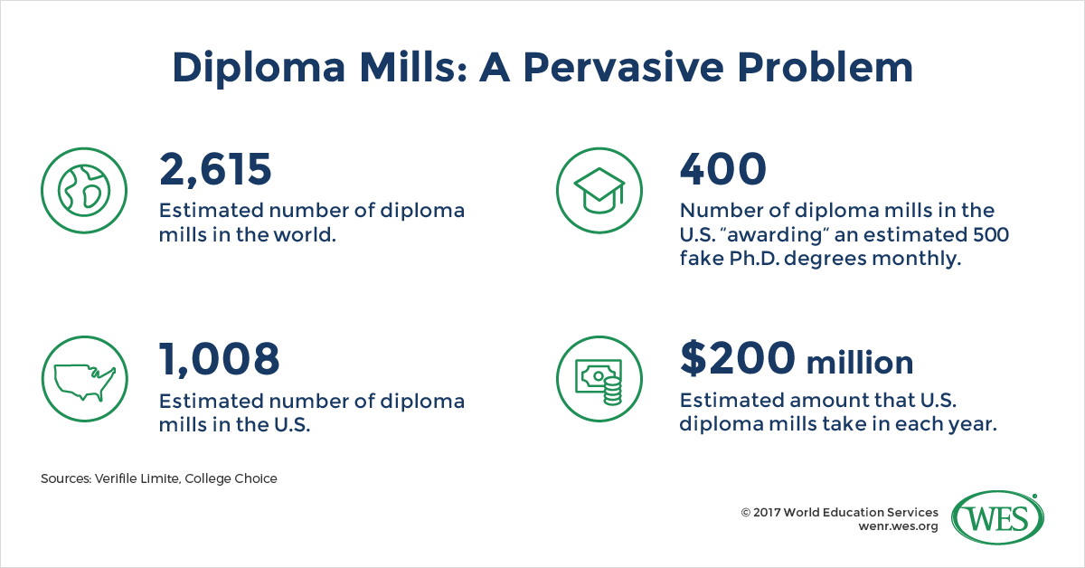
“Crypto is Scammy and Needs Consumer Protection”

Slide 37
Fact or Fiction? Crypto is for Criminals

Slide 38
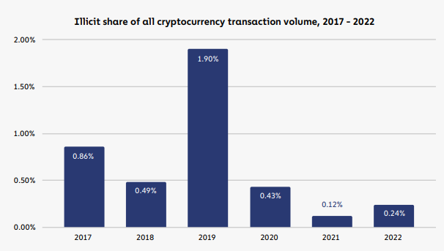
“Crypto is for Criminals”

Slide 39
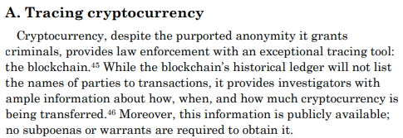
“Crypto is for Criminals”
- The Department of Justice

Slide 40
Fact or Fiction? Crypto is bad for the environment

Slide 41
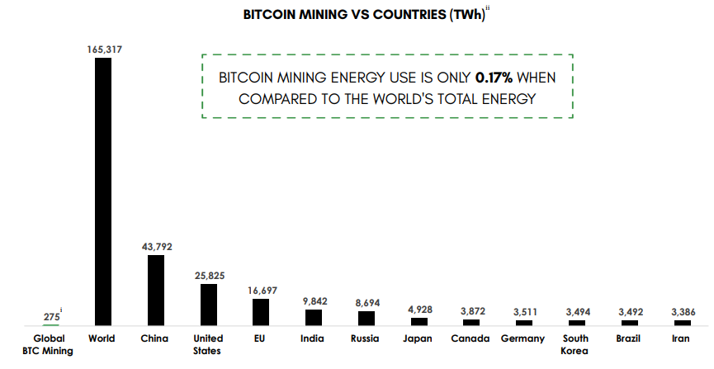
“Crypto is Bad for the Environment”

Slide 42
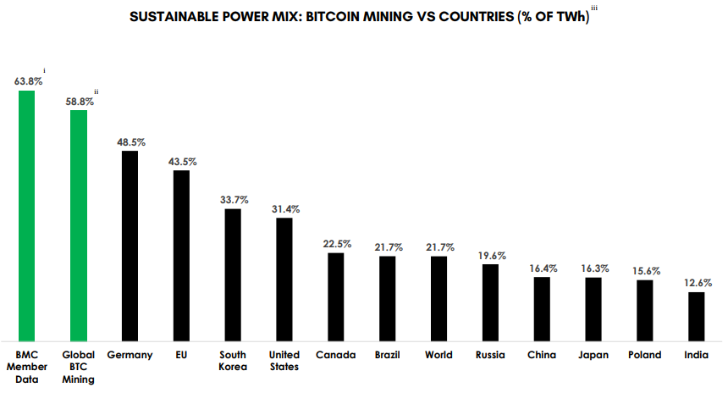
“Crypto is Bad for the Environment”

Slide 43
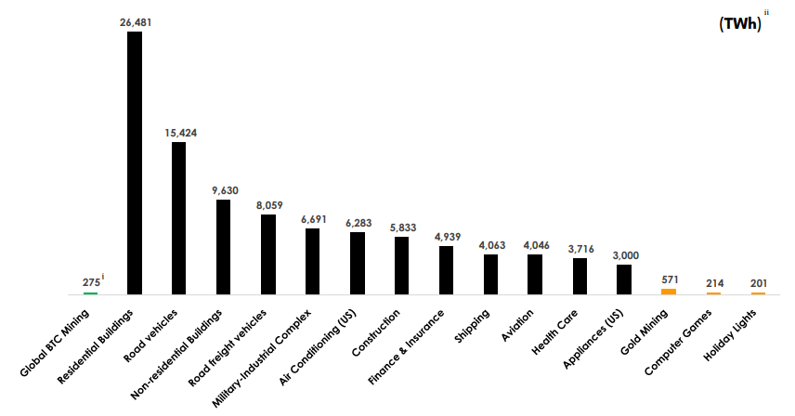
“Crypto is Bad for the Environment”

Slide 44
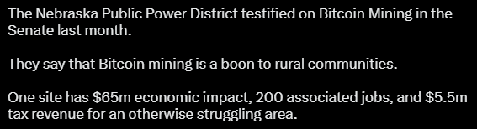
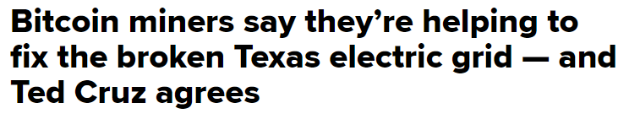
“Crypto is Bad for the Environment”
POLITICIAN

Slide 45
There Are Risks
Risk Type* | Example | Potential Mitigation
Operational | Losing private keys & thus access to the assets | Third-party custody
Market | Price volatility | Investment horizon, stablecoins, use of derivatives/hedging
Cyber | Hacking & misappropriation | Advanced security & internal controls over authorization
Regulatory | Uncertainty | Legal consultation
Financial reporting | Incorrect accounting classification, measurement, & reporting | Proper application of GAAP
Tax implications | Misunderstanding of taxable transactions | Understanding tax regulations, complete/accurate data collection

Slide 46
Proper Controls With Guidance From FORVIS
Custody Policy
Conversion Policy
Self-Custody
Qualified Custodian
Acceptable hold periods and volatility triggers
Convert immediately
Hot or cold wallet?
SOC 1/2 Reports
Two-Factor Authentication
Who has access?
Who has access?
Who is approved to direct trading/transactions?
How will you record & reconcile the FMV of gift received?
Roll forward controls
IRS Form 8282
Multi-signature wallet?
Record Retention Policy
Types of Assets to Accept

Slide 47
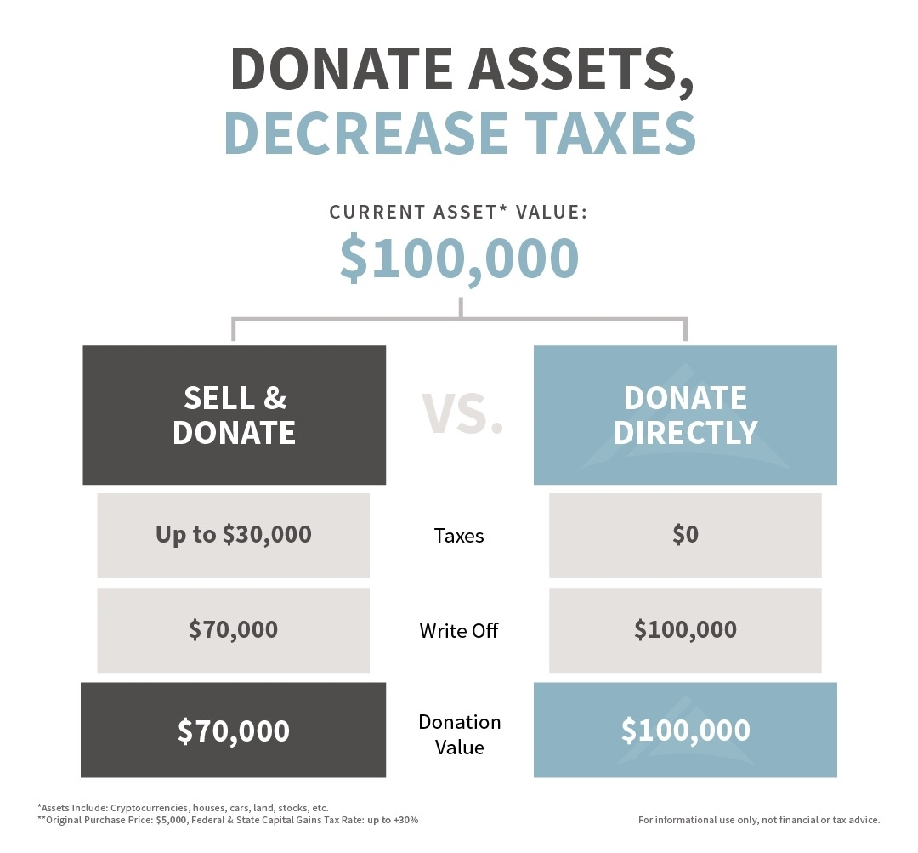
Donors Have a Great Reason to Give Crypto
How does the IRS treat crypto?
Treated as property similar to stock
What are the benefits of donating crypto?
Charitable Contribution Credit
Avoid the Capital Gains tax
Maximizing your gift

Slide 48
How Donors Claim the Deduction
$250 - $499
Standard non-cash donation receipt
$500 - $4,999
Standard non-cash donation receipt
Donor must file Form 8283
$5,000 - $499,999
Standard non-cash donation receipt
Form 8283 signed by Org & Qualified Appraiser
Qualified Appraisal
$500,000 or more
Standard non-cash donation receipt
Form 8283 signed by Org & Qualified Appraiser & submitted to IRS
Qualified Appraisal

Slide 49
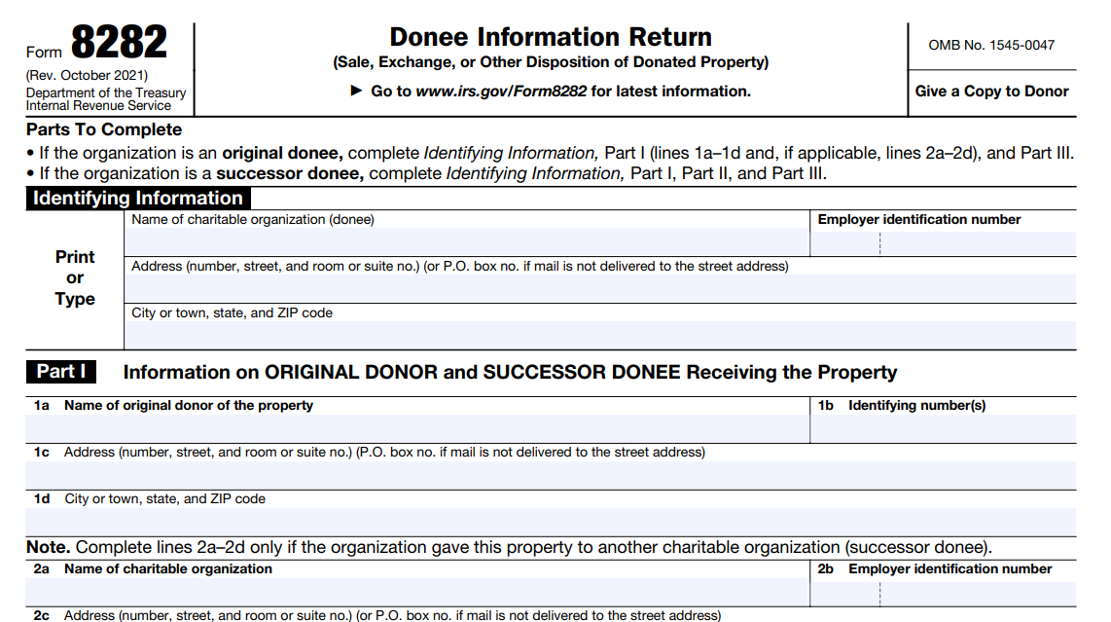
Form 8282
If charitable organization sells/converts the cryptocurrency donation within three years
Reported to IRS & Donor
For IRS to match deduction by donor with FMV

Slide 50
The Market Moves Fast
Prices may be down from all-time highs right now
Significant price appreciation in 2023 from lows
Client that received $21M crypto donation in 2023
What if you didn’t have a plan in place when donor wanted to donate $21M in crypto?

Slide 51
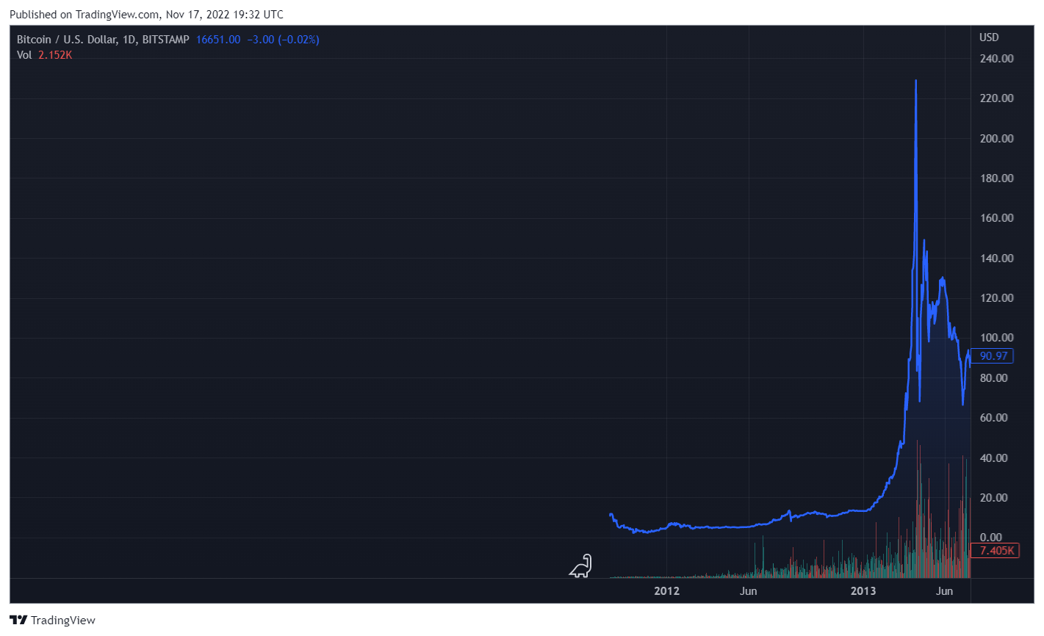
Bitcoin Price 2012 – 2013

Slide 52
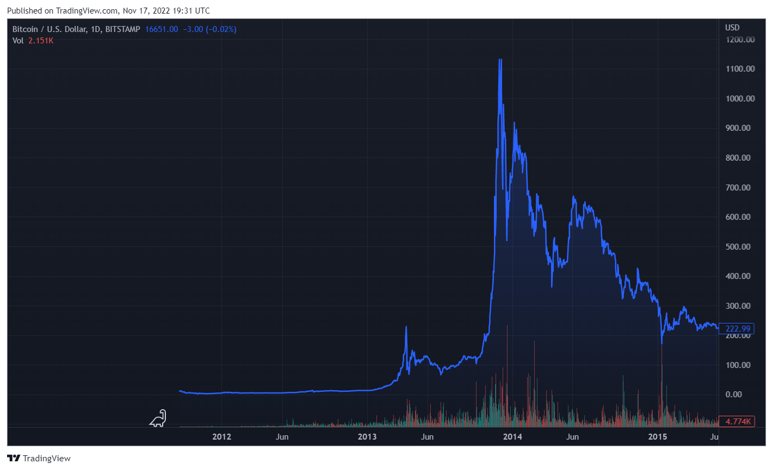
Bitcoin Price 2012 – 2014

Slide 53
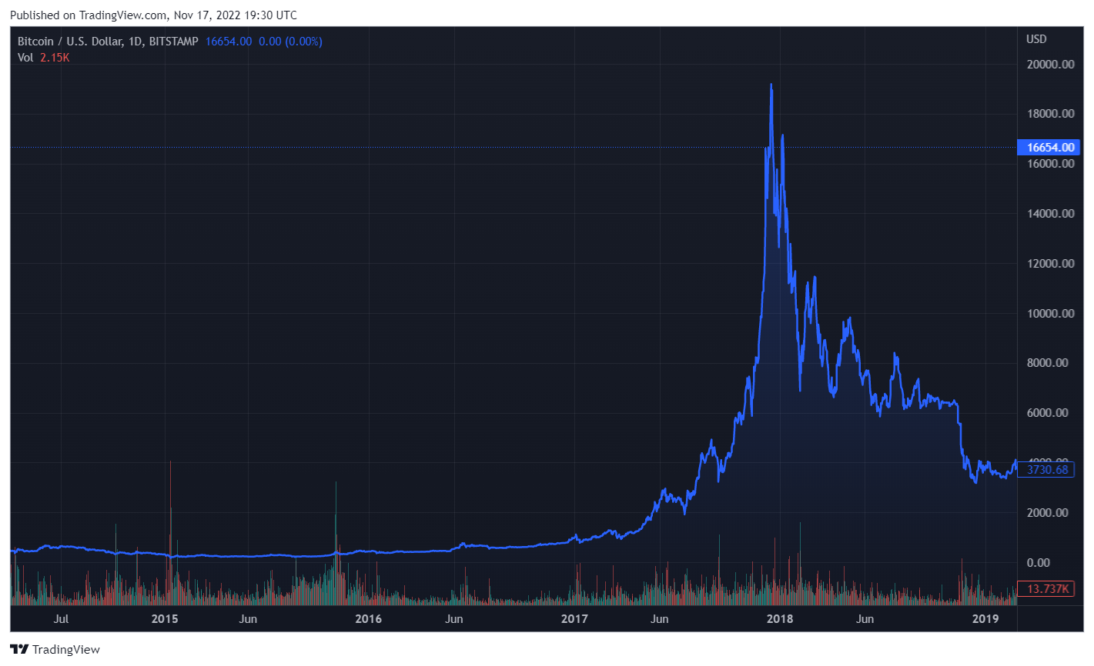
Bitcoin Price 2014 – 2018

Slide 54
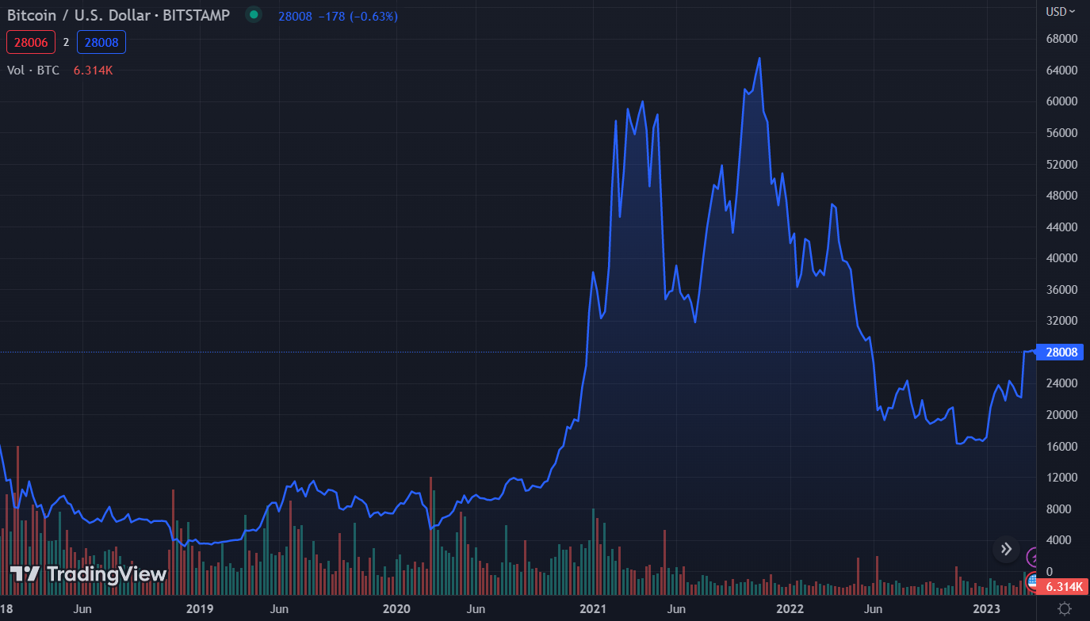
Bitcoin Price 2018 – 2023

Slide 55




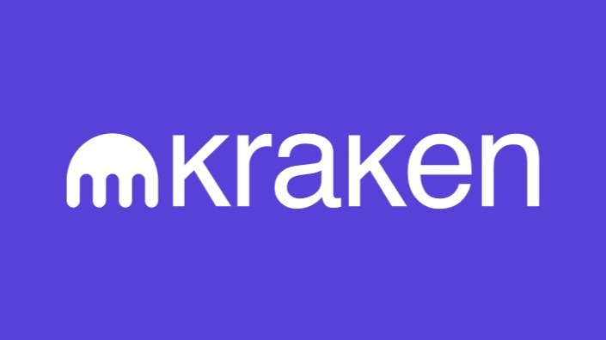

Crypto Services and Exchanges
Notes:
Three ways to accept crypto for NFPs
Services like Every.org are intermediate 501c3s and will allow the NFP to accept crypto/convert/receive cash without ever having to custody it. This is also cost effective because Every.org is a nonprofit and does not charge fees. (Every.org uses Coinbase as its custodian). They also handle donor reporting.
Services like GivingBlock and Engiven will allow NFPs to accept crypto and either convert or hold. They are geared toward NFPs so they handle tax reporting as well.
Crypto exchanges are cost effective; however require more active work on the part of the NFP in terms of reporting, managing the liquidation of assets, etc.
Point out that Coinbase and others have institutional accounts and has Soc 1 Type 2 and Soc 2 Type 2 reports
Also point out that if you transact in NY, you'll need a service that has a NY DFS Bitlicense.

Slide 56
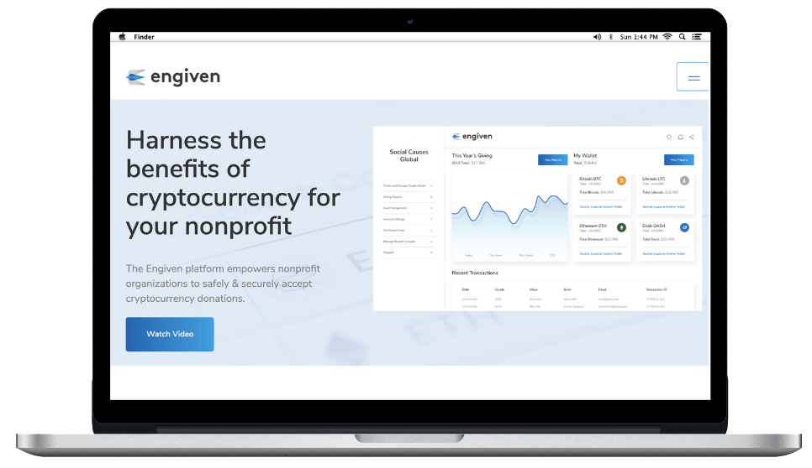

A Solution | Engiven
We empower your nonprofit to accept crypto Safely & Securely
Automatic Liquidation or Custody options
Qualified appraisals completed at no extra cost
Generated non-cash gift receipts and 8283/8282 filings for donors
1st Crypto Donation Platform to receive SOC2 Compliance

Slide 57
Engiven + FORVIS Relationship
Preferred pricing
Dedicated webpage & support videos
“White glove” service
Dedicated support team

Slide 58
Show of Hands
Do you think digital assets & blockchain will play a role in our more digital world 10 years from now?

Slide 59
Questions?

Slide 60
Thank you!

Slide 61
TRIVIA TIME

Slide 62
Get To Know Your Form 990

Slide 63
Agenda
Form 990 Overview
Public Support Test
Common Errors
Questions

Slide 64
Form 990 Overview

Slide 65

Form 990
Form 990 is an “informational return” not a “tax return”
Form 990 must be complete & accurate
Form 990 must be available for public inspection
Form 990 must be filed electronically
There are substantial penalties for non-compliance
Late filing penalties
Revocation of exempt status for those failing to file for 3 consecutive years

Slide 66


Public Disclosure
Maintain a public disclosure copy of Form 990 and 990-T
Form 1023 & attachments also (exception if you did not have a copy on July 15, 1987)
Form 990 and in some cases Form 990-T are available on Guidestar (www.guidestar.org)

Slide 67


IRS Organization Search
Replaces EO Select Check
Images of newly filed 990s
Added monthly
Mobile friendly
Determination letters issued after 1/1/14
https://www.irs.gov/charities-non-profits/tax-exempt-organization-search

Slide 68
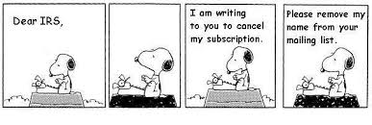
Who is looking at Form 990?
Congress
IRS
Media
General public
Donors
Vendors
State Attorneys General
Other non-profits in your industry
Other watchdog groups

Slide 69
Core Form
Part III: Program Service Accomplishments
Describes in detail the mission and types of programs the organization conducts including revenue and expenses
Part IV: Checklist of Required Schedules
Various questions to help pinpoint exactly how many additional schedules will be attached
Part V: Statements Regarding Other IRS Filings & Tax Compliance
Questions about foreign banking, the need to file a 990-T, items the IRS will need to know about
Part VI: Governance, Management & Disclosure
Various questions and disclosures that provide more detail into who manages the organization and policies in place (all best practices)
Part VII: Compensation of Officers, Directors, Key Employees, Highest Compensated Employees & Independent Contractors
Parts VIII, IX, X: Financials
There are common reconciling differences with the audit report

Slide 70
Schedules
Schedule A: Public Charity Status & Public Support Test
Schedule B: Schedule of Contributors
Schedule C: Lobbying Activities
Schedule D: Supplemental Financial Statements
Schedule E: Schools
Schedule F: Activities Outside the US
Schedule G: Fundraising
Schedule H: Hospitals
Schedule I: Grants & Other Assistance

Slide 71
Schedules (continued)
Schedule J: Compensation Information
Schedule K: Tax-Exempt Bonds
Schedule L: Transactions with Interested Persons
Schedule M: Noncash Contributions
Schedule O: Supplemental Information
Schedule R: Related Organizations

Slide 72
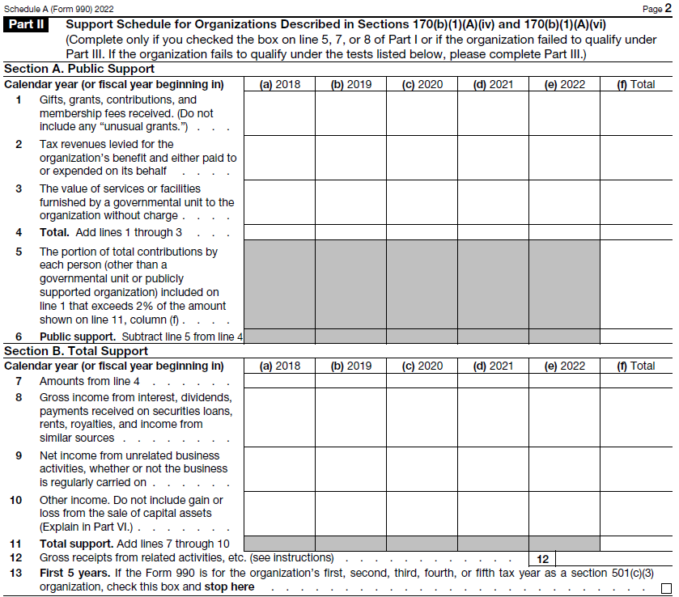
Public Support Test Part II

Slide 73
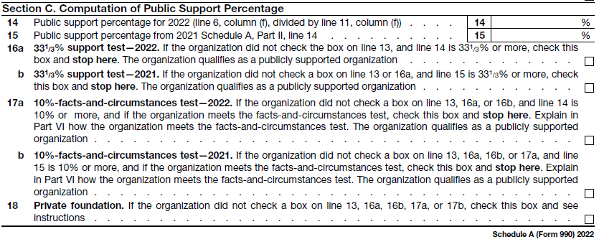
Public Support Test Part II Cont.

Slide 74
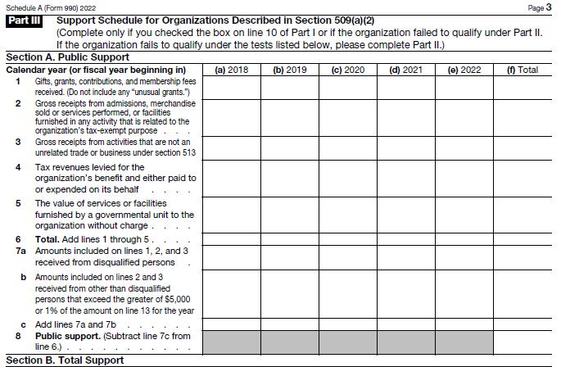
Public Support Test Part III

Slide 75
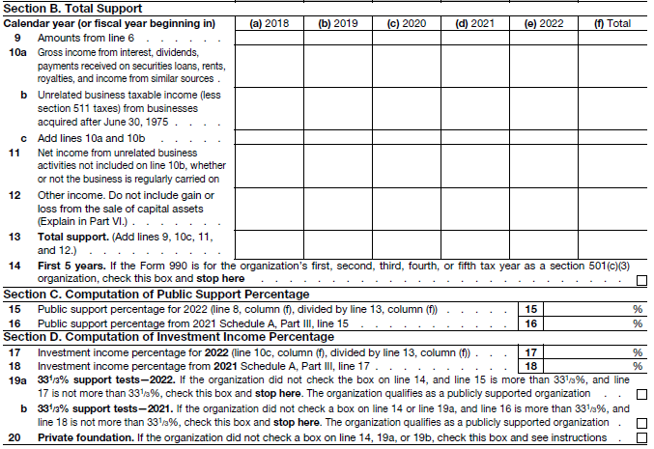
Public Support Test Part III Cont.

Slide 76
Common Errors

Slide 77
Common Reporting Errors
Missing applicable schedules
Answers to Part IV, Checklist of Required Schedules shows which schedules should be attached.
IRS can deem missing schedules an incomplete return and assess late filing penalties.
Note Part IV, Line 38 must be “yes” and Schedule O must contain applicable narratives.

Slide 78
Common Reporting Errors
Board Members and Independence
Number of voting board members at year end
Independence impaired if:
Receiving any W-2 compensation
Receiving 1099 of $10,000 or more
Schedule L transactions in excess of specified thresholds reported for organizations owned more than 35% by the board member, providing compensation to a relative of the board member

Slide 79
Common Reporting Errors
Part VII, Section A, Compensation
Fiscal year filers report compensation using data from the calendar year ending within the fiscal year
Use W-2 and 1099
Deferred compensation (ER portion) and nontaxable benefits (EE+ER portions) should be reported
All voting board members serving during the year should be listed, and officers of the board are checked as both director and officer
List top management official and top financial official as officers

Slide 80
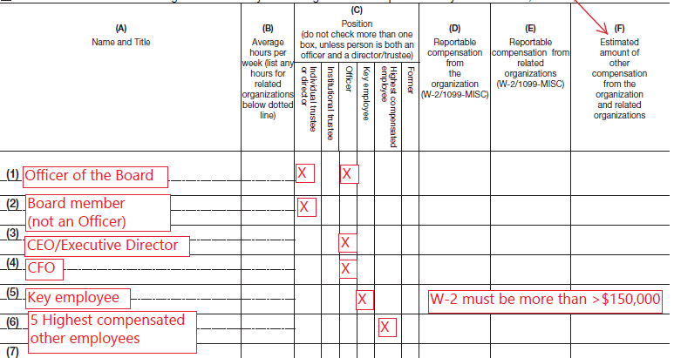

Slide 81
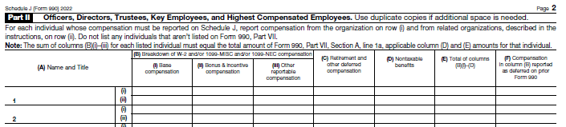

Slide 82
Common Reporting Errors
Part VII, Section B, Independent Contractors
List five highest compensated independent contractors that received more than $100,000 of compensation.
Should be reported using calendar year data.
A 1099 report may not include all vendors.

Slide 83
Common Reporting Errors
In-kind donated services
Donations of advertising, rent, compensation
Included in financial statements, but should be excluded from both revenue and expenses on the Form 990
Do not report as noncash on Schedule B, Schedule of Contributors, or Schedule M, Noncash Contributions

Slide 84
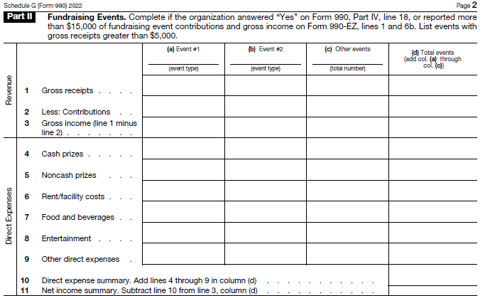
Fundraising Events

Slide 85
Common Reporting Errors
Anonymous donors
Only report as “anonymous” on Schedule B, Schedule of Contributors, if nobody at the organization knows the identity.
Donors are still anonymous to the public as the names and addresses of contributors are not subject to public disclosure.

Slide 86
Thank You!

Slide 87


Slide 88
10-minute break

Slide 89
GAAP Update
Allison Swaters / May 23, 2023

Slide 90
Agenda
Leases
Contributed Nonfinancial Assets
Current Expected Credit Losses (CECL)
Reference Rate Reform
FASB Projects – Crypto Assets, Software Costs, Leases

Slide 91
Effective Dates – ASC 842
Prior to June 2020 ASU
Public Entities & NFP Conduit Bond Obligors
Annual & interim reporting periods beginning after December 15, 2018
All Other
Annual reporting periods beginning after December 15, 2020
If elect deferral in June 2020 (ASU 2020-05)
Public NFPs & NFP Conduit Bond Obligors
Annual & interim reporting periods beginning after December 15, 2019
Private Companies & NFPs
Annual reporting periods beginning after December 15, 2021
This is the last group

Slide 92
ASU 2018-11: Transition Options
Lease Accounting | FY 20X1 (Comparative Period) | FY 20X2 (Year of Initial Adoption)
Original transition method provided in ASU 2016-02 | 842 | 842
Additional transition method provided in ASU 2018-11 | 840 | 842
Notes:
Chad

Slide 93
Identifying a Lease
The New Primary Determinant for On-/Off-Balance Sheet Treatment
Identified Asset
Explicitly or implicitly specified
Not able to substitute
Right to Control
Decision-making authority
Substantially all the economic benefits
+
Lease
Notes:
Chad

Slide 94
Short-Term Leases
Leases, at commencement date, have a term of 12 months or less & do not include option to purchase underlying asset that the lessee is reasonably certain to exercise
This policy election must be disclosed in the financial statements
Warning: The existence of lease extensions & the likelihood of extending the arrangement must be considered in determining the term
Entities can make a formal policy election to not recognize short-term leases on the balance sheet

Slide 95



Contracts With Multiple Components
Lease Component
Nonlease Component
Not a Separate Component
A separate ROU for an asset
Lessee can benefit from the ROU of the underlying asset either on its own or together with other readily available resources. The use is neither highly dependent on nor interrelated with other assets
Payments accounted for as a sperate lease
An activity that transfers a separate good or service to the customer, e.g., supplies/disposables
Includes maintenance services
Allocated payments are nonlease period expense
Related to administrative tasks to initiate the lease & payment of lessor costs that do not transfer a separate good or service separate from the ROU asset
Includes payments for insurance or property taxes
Payments are part of the lease payment, not separately allocated

Slide 96
Lessee Model – Initial Measurement
Lease liability (obligation to make the lease payments)
Measured at the present value of the future minimum lease payments
Right-of-use asset
Lease liability + initial direct cost + lease prepayments – lease incentives received
Discount rate
Use the rate charged by the lessor if known
The incremental borrowing rate
All private companies & NFPs may elect to use the risk-free rate rather than its borrowing rate (& can use both by class of underlying asset)
Rate as of the implementation date for the remaining lease term (no need to go back in time)

Slide 97
Lessee Model – Subsequent Accounting
Annual expense recognition & subsequent amortization of ROU asset depends on lease classification
Finance lease
Unwind liability using the effective interest method
Front-loaded expense pattern similar to capital leases under ASC 840 with interest & amortization recognized separately
Interest determined on the lease liability in each period during the lease term as the amount that produces a constant periodic discount rate
ROU asset generally amortized on a straight-line basis

Slide 98
Lessee Model – Subsequent Accounting
Operating lease
Unwind liability using the effective interest method
Straight-line expense over term
ROU asset: Reduced by the difference between the annual straight-line lease expense & the annual interest cost on the lease liability, i.e., amortize the asset to achieve straight-line total lease expense

Slide 99
Leases – Discount Rate
Choices
Use the rate charged by the lessor if known
The incremental borrowing rate
All private companies & NFPs may elect to use the risk-free rate rather than its borrowing rate (& can use both by class of underlying asset)
Can use the rate as of the implementation date (no need to go back in time)
Clarifications made in ASU 2021-09

Slide 100
ASU 2020-07 – Contributed Nonfinancial Assets
Effective for fiscal years beginning after June 15, 2021 (effective now)
Purpose – increase transparency of about the measurement of contributed nonfinancial assets
Does not change fair value measurement requirements
Contributed nonfinancial assets presented as a separate line in statement of activities
Additional disclosure requirements
Notes:
The purpose of the ASU 2020-07 is to clarify the presentation and disclosure of contributed nonfinancial assets with an intention to provide the reader of the financial statements a clearer understanding of what type of nonfinancial assets were received and how they are used and recognized by the NFP.
Present contributed nonfinancial assets as a separate line item in the statement of activities, apart from contributions of cash and other financial assets.
2. Disclose: a. A disaggregation of the amount of contributed nonfinancial assets recognized within the statement of activities by category that depicts the type of contributed nonfinancial assets. b. For each category of contributed nonfinancial assets recognized (as identified in (a)): i. Qualitative information about whether the contributed nonfinancial assets were either monetized or utilized during the reporting period. If utilized, an NFP will disclose a description
of the programs or other activities in which those assets were used. ii. The NFP’s policy (if any) about monetizing rather than utilizing contributed nonfinancial assets. iii. A description of any donor-imposed restrictions associated with the contributed nonfinancial assets. iv. A description of the valuation techniques and inputs used to arrive at a fair value measure, in accordance with the requirements in Topic 820, Fair Value Measurement, at initial recognition. v. The principal market (or most advantageous market) used to arrive at a fair value measure if it is a market in which the recipient NFP is prohibited by a donor-imposed restriction from selling or using the contributed nonfinancial assets.

Slide 101
ASU 2020-07 – Contributed Nonfinancial Assets
Disclosure Requirements
Disaggregation of amounts by type of contributed nonfinancial assets
For each category
Information about whether assets were monetized or utilized and a description of the program in which the assets were used
NFP’s policy (if any) about monetizing or using assets
Description of donor-imposed restrictions
Description of fair value measurements
Principal market (or most advantageous market) used to arrive at fair value

Slide 102
CECL – Overview
Effective for fiscal years that begin in 2023
Applies to loans & trade receivables (including student receivables)
Does not apply to contributions/grants receivable
Need to consider historical losses plus current conditions plus/minus predictions/forecasts
This is different than the amount expected to collect under revenue recognition (Topic 606) & the application of discounts to tuition
Notes:
FASB ASC Topic 326, Financial Instrument — Credit Losses,
ASU 2016-13, Measurement of Credit Losses on Financial Instruments
Mainly a financial services standard but student receivables and loans are in scope.
ASU 2016-13 introduced the “current expected credit losses” (CECL) model, which requires organizations to estimate credit losses immediately upon exposure. The guidance applies to financial assets measured at amortized cost including financing receivables (loans) and trade receivables also includes held to maturity debt securities. Most independent institutions already reflect an estimate of credit losses in their allowances for doubtful accounts at the time loans and receivables are recorded. As a result, 2016-13 is not expected to have a significant impact on financial position.
The current expected credit loss (CECL) model under Accounting Standards Update (ASU) 2016-13 aims to simplify US GAAP and provide for more timely recognition of credit losses. The ASU adds to US GAAP an impairment model known as the current expected credit loss (CECL) model, which is based on expected losses rather than incurred losses.
Current GAAP requires an “incurred loss” methodology for recognizing credit losses that delays recognition until it is probable a loss has been incurred. This model has been criticized for restricting an organization’s ability to record credit losses that are expected, but do not yet meet the “probable” threshold.

Slide 103
CECL – Disclosures
Required disclosures to enable financial statement user to understand
The credit risk inherent in a portfolio & how management monitors the credit quality of the portfolio
Management’s estimate of expected credit losses
Changes in the estimate of expected credit losses that have taken place during the period (this includes both qualitative descriptions of how the estimate changed & quantitative rollforward of allowance for credit loss by portfolio segment)
Notes:
to clarify presentation and disclosure of contributed nonfinancial assets and to provider reader a clearer understanding of what type of nonfinancial assets were received, how they are used and recognized

Slide 104
Reference Rate Reform
Reference rates such as USD LIBOR & other inter-bank offered rates are planned to be phased out & replaced by new rates that are tied to observable arms-length transactions. The original phase-out date was December 31, 2021
ASU 2020-04, Reference Rate Reform (Topic 848): Facilitation of the Effects of Reference Rate Reform on Financial Reporting & ASU 2021-01, Reference Rate Reform (Topic 848): Scope were issued to provide optional accounting relief related to hedge accounting & contract modifications. That relief is set to expire on December 31, 2022 (“sunset date”) – See next slide for extension of sunset date

Slide 105
Reference Rate Reform
On March 5, 2021, LIBOR’s administrator indicated that major tenors of USD LIBOR will cease to be published as of June 30, 2023
FASB voted at the December 15, 2021 meeting to propose that the sunset date be extended to December 31, 2024. ASU 2022-06 was issued in December 2022 affirming this decision
Reminders for NFPs
Discuss timing with your creditor/lender
Consider the guidance in Topic 848
Review contracts & agreements that may be affected by reference rate reform

Slide 106
FASB Projects
Three projects that could have an impact on colleges & universities
Crypto Assets – all that meet the definition would be required at fair value
Software Costs – modernize the various literature with a single model
Leases – Common Control (exposure draft is issued)
Available to private companies & nonprofits but not available to nonprofits with conduit debt
Provide a practical expedient to use written terms to determine if a lease exists & if so its classification (rather than the shorter of life of asset or lease term)
Leasehold improvements amortized over the economic life of the improvements as long as lessee continues to use the underlying asset
If stopped using lease it is a transfer between entities under common control
Notes:
Crypto – There is no specific US GAAP on crypto assets. Most crypto assets meet the definition of, and are therefore accounted for as, intangible assets, held at cost and evaluated for impairment.
Software Costs – last update 1/26/2023
https://www.fasb.org/Page/ProjectPage?metadata=fasb-Accounting-for-and-Disclosure-of-Software-Costs
Objective:
The objectives of this project are to (1) modernize the accounting for software costs and (2) enhance the transparency about an entity’s software costs.

Slide 107
Thank you!

Slide 108
Lunch

Slide 109
Inflation Reduction Act Tax Credits
FORVIS is a trademark of FORVIS, LLP, registration of which is pending with the U.S. Patent and Trademark Office.

Slide 110
Tax Credits & Higher Education Institutions

Slide 111
Tax Credits
Inflation Reduction Act of 2022
The Inflation Reduction Act provides not-for-profit, tax exempt entities as well as state, local and Tribal governments the opportunity to obtain benefits from investments in clean energy. To further promote new clean energy investments, the Inflation Reduction Act allows these types of entities to receive certain tax credits as direct payments from the IRS, simplifying access to key incentives and supporting investments to support the environment in their communities. Public and private universities and colleges are now eligible.
Not-for profit organizations are now eligible for energy tax credits and receive credit for the new capital investment in clean energy initiatives. Eligible entities may include governmental, higher education (public and private), civic and charitable organizations, rural electric cooperatives, political organizations and others.

Slide 112
Credit Programs available to Not-For-Profit

Slide 113
How to Monetize
Tax-exempt and government entities often have no tax liability, so a nonrefundable tax credit might have limited usefulness.
Inflation Reduction Act creates a new mechanism called “direct pay” that functions in many ways like a refundable credit.
The election must be made no later than the due date, including extensions, for the tax return of the year in which the election is made (or a date determined by Treasury if the eligible entity is not required to file a return), but in no event earlier than 180 days after the enactment of Section 6417.
Eligible university or college makes a Section 6417 “direct pay” election, its credit will be treated as a payment against tax and refunded to the school if there is no UBIT against which to apply it.
Inflation Reduction Act offers most schools an opportunity to turn the new credits into cash.

Slide 114
Credit Amounts
The credits have a base credit and bonus credit structure. For example, if you meet the prevailing wages and labor standards, you can raise the credit by a multiplier of five. The amount of the tax credit varies depending on the type of project and program, the date construction of the project begins, the date the project is placed in service, and other factors.
The 2022 base rate for the production tax credit is currently $.55 cents per kilowatt-hour (kWh) to be adjusted annually for inflation, and the base rate for the investment tax credit is currently 6%. If the project either (i) does not exceed 1 megawatt (1 MW) or (ii) meets federal prevailing wage and apprenticeship standards, these rates may increase 5x to 2.75 cents per kWh for the production tax credit and 30% for the investment tax credit.

Slide 115
Requirements – Prevailing Wage
The wage determination is the list of basic hourly wage and fringe benefit rates for each classification of laborers and mechanics in a predetermined geographic area for a particular type of construction. The information can be found at www.sam.gov. If the information is not available, the taxpayer must contact Wage and Hour Division to obtain the information.
To satisfy the Apprenticeship Labor Hour Requirements, apprentices must work a certain percentage of the total labor hours based on when construction began of the qualified facility:
Construction began before January 1, 2023: 10% of total labor hours
Construction began after December 31, 2022, and before January 1, 2024: 12.5% total labor hours
Construction begins after December 31, 2023: 15% total labor hours
The credits also may be reduced if tax-exempt bonds are used to finance the project.

Slide 116
Public Universities & Colleges
Unfortunately, a possible error in the Act may prevent some public universities from utilizing the new credit opportunities. The new direct pay election, which lifts prior restrictions and offers easy monetization, is available to all 501(c)(3) colleges and universities, private and public.
Not all public universities may have 501(c)(3) status though. Public universities are generally classified as either 1) an integral part of their state, 2) a political subdivision, or 3) an instrumentality of their state. The first two categories are eligible for the direct pay election. The third category is absent from the eligibility list.

Slide 117
Section 179D – Energy Efficient Commercial Buildings Deduction

Slide 118
179D Credit- Introduction
According to Section 179D(c):
Retrofits-- Installation of:
“Interior lighting systems
The heating, cooling, ventilation, and hot water systems, or
The building envelope”
“Must be part of a plan designed to reduce the total annual energy and power costs with respect [to this property]”
Reference point for % energy cost reduction: Building meeting minimum requirements of “ASHREA”

Slide 119
Eligibility & Cap
Eligibility– Greatly broadened, newly including designers of buildings owned by (among others):
Not-For-Profit Organizations
Private Foundations
Hospitals
Shift from lifetime cap to credit eligible:
Every 3 years if privately owned
Every 4 years if credit to a party other than the taxpayer
ASHREA – comparison point 4 yr. versus 2 yr. before construction completion

Slide 120
Credit Calculation
New law applies to property PIS after 12/31/22
Deduction does not exceed the product of:
Square footage of the building and
“Applicable dollar value”
Structure of new credit: “base” and “bonus” deduction
Base- Sliding scale of $.50 per square foot for energy savings of 25% and up to $1 per square foot for energy savings of 50% or greater
Bonus- Sliding scale of $2.50 per square foot for energy savings of 25% and up to $5 per square foot for energy savings of 50% or greater
Wage & apprenticeship requirements, based on % energy reduction
Overall– potential increase from $1.88 (old law) to $5 (new law)

Slide 121
How To Monetize
Historically, tax-exempt and government entities often are unable to utilize deductions, so Congress has allowed most government entities - including many public universities and colleges - to allocate their deduction to the designer of the building, effectively selling the deduction for a negotiated amount
Architects, engineers and other designers (general contractors)
Private universities and colleges are now included due to the Inflation Reduction Act
Parameters need to be established on allocation (sale) of deduction – it is considered a tax asset
Some states are evaluating if prohibiting public universities and colleges from soliciting payment in exchange for the Section 179D deduction
Florida and Ohio

Slide 122
Questions?

Slide 123
Thank You!

Slide 124
10-minute break

Slide 125
Cybersecurity Risks in a Post COVID-19 World

Slide 126
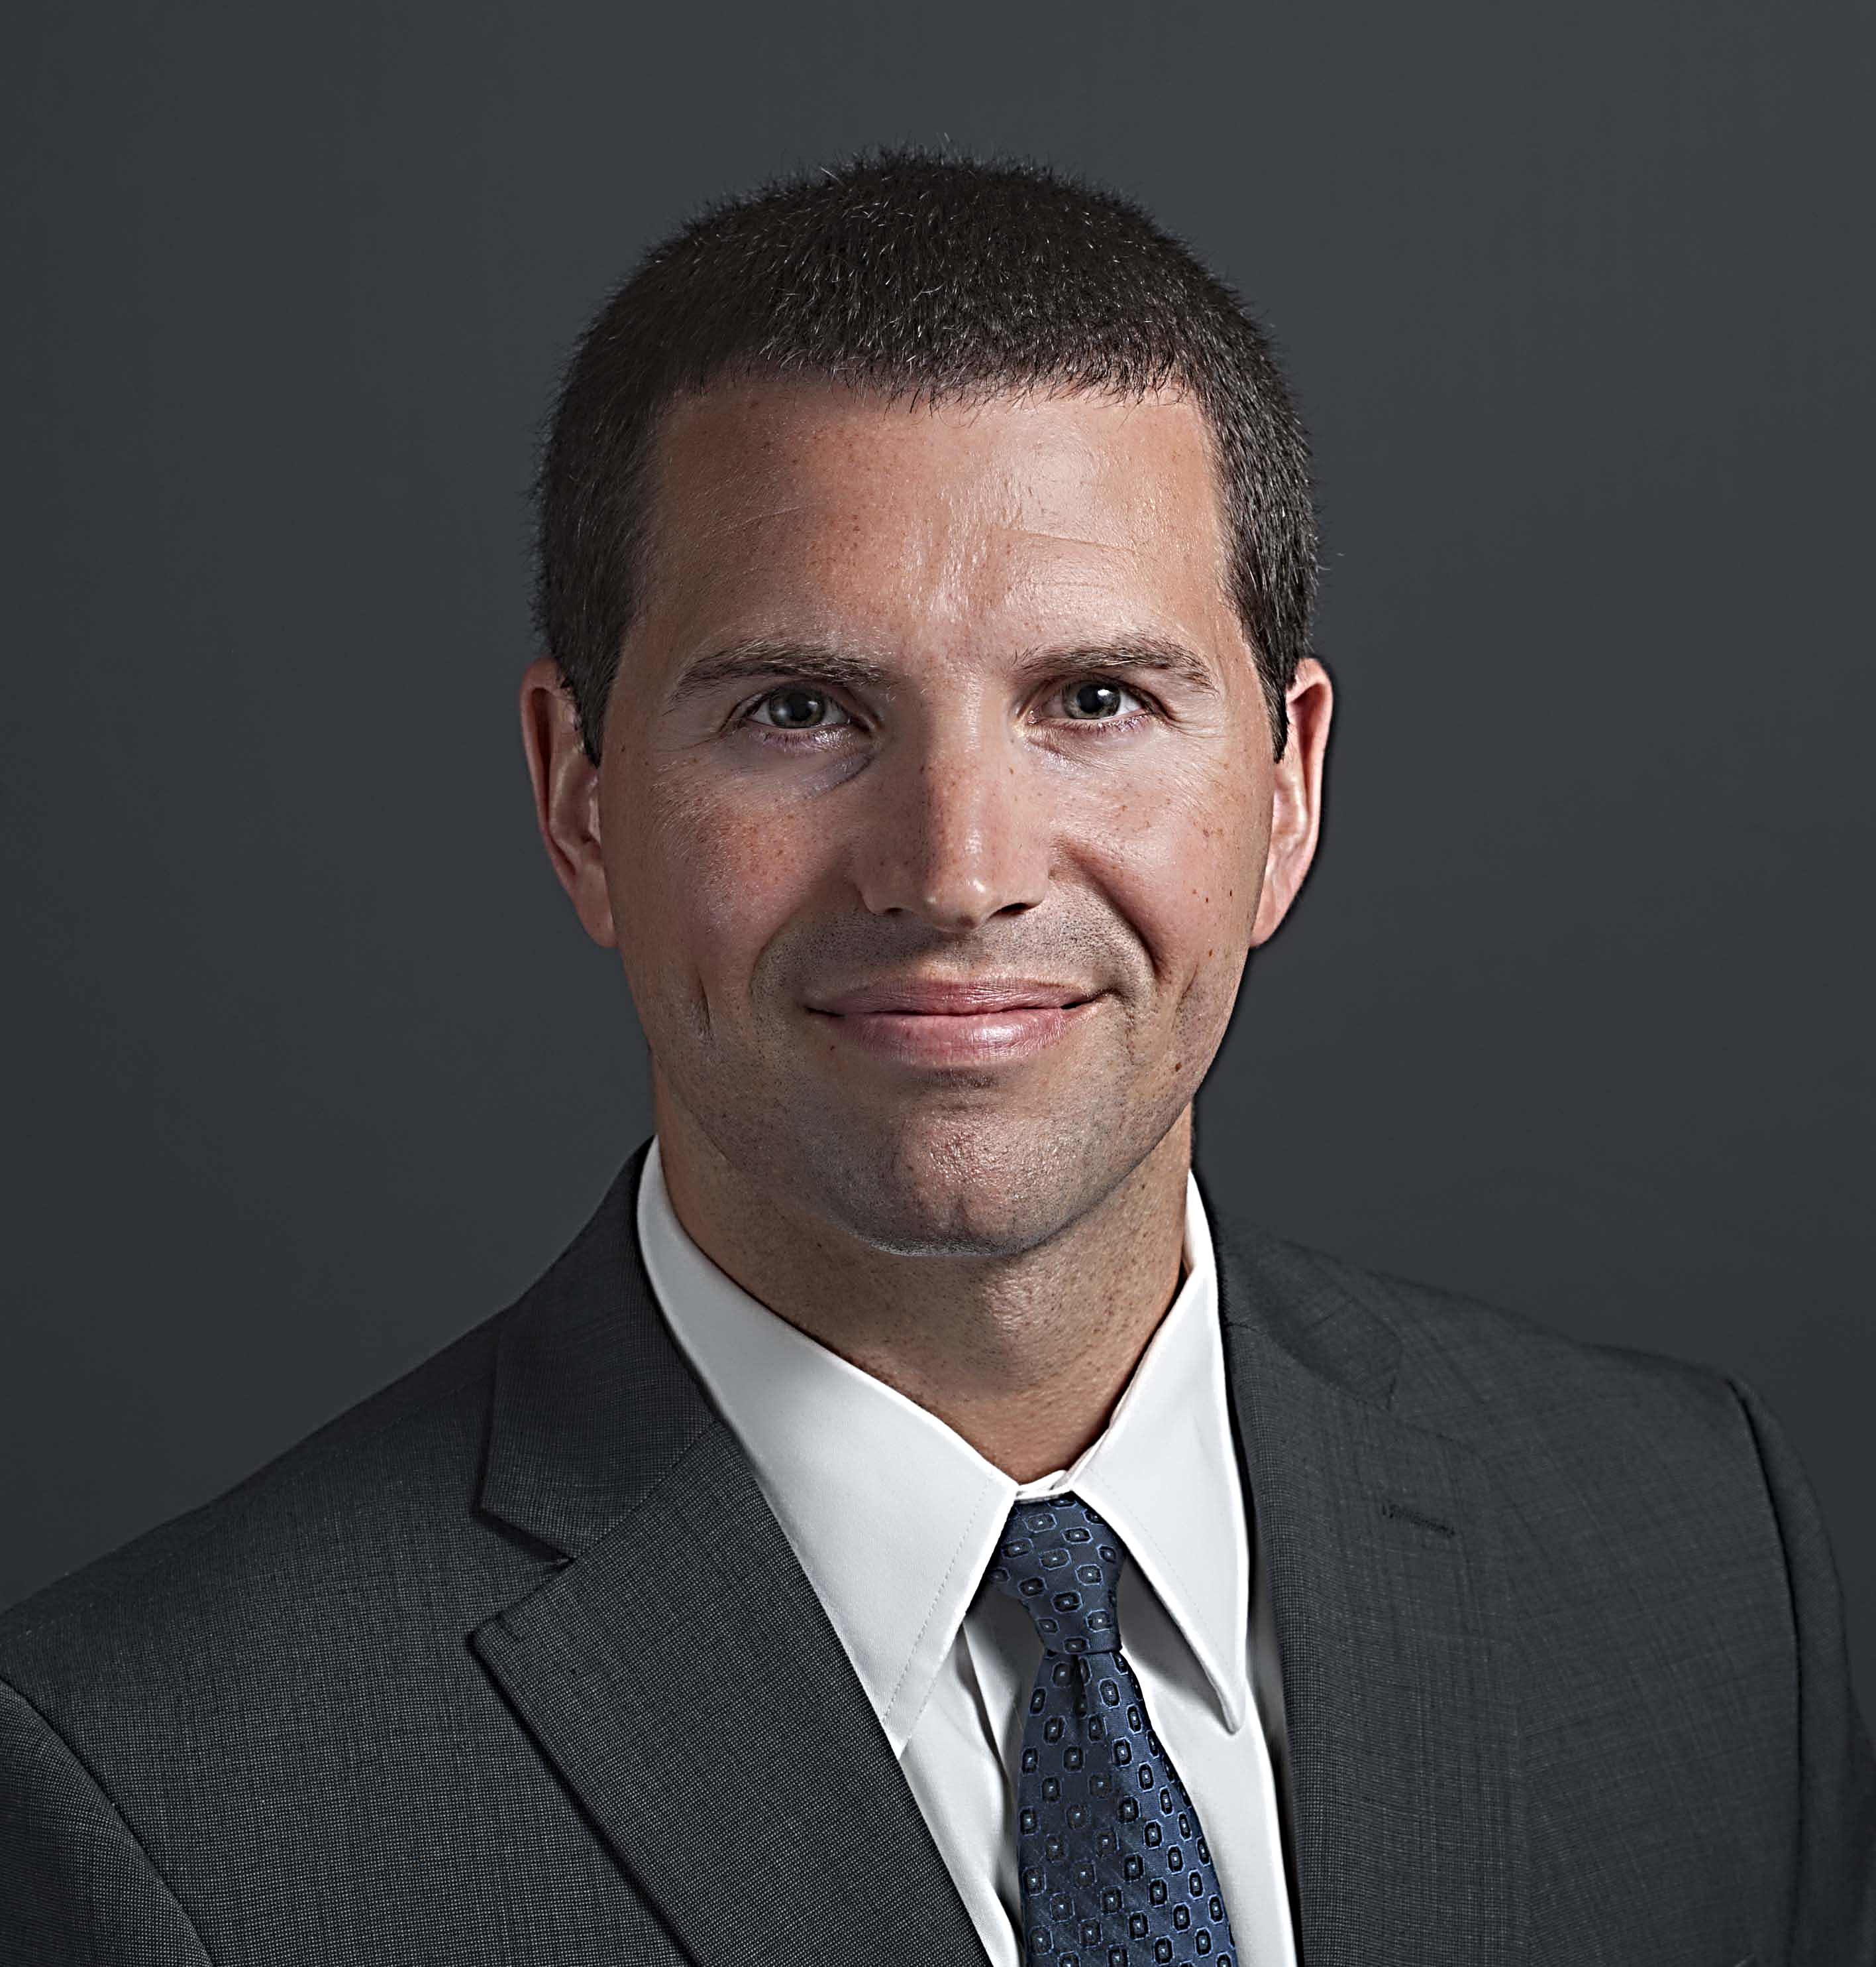
Presenter
Cy Sturdivant, CISA®
Director | Advisory
Nashville, Tennessee
cy.sturdivant@forvis.com
615.988.3596

Slide 127
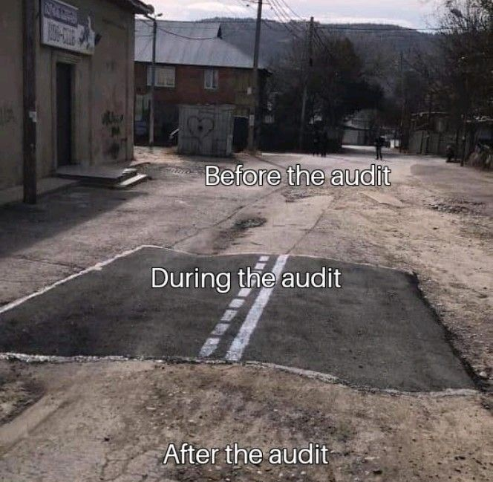
My world in a nutshell!
Notes:
I see a lot but there is so much more I do not see! Be sure you are concerned and engaged at all times, not just when someone is looking.
Economy is turning down / recession – don’t cut budgets in Cyber

Slide 128
Cybersecurity Industry Trends & Statistics

Slide 129
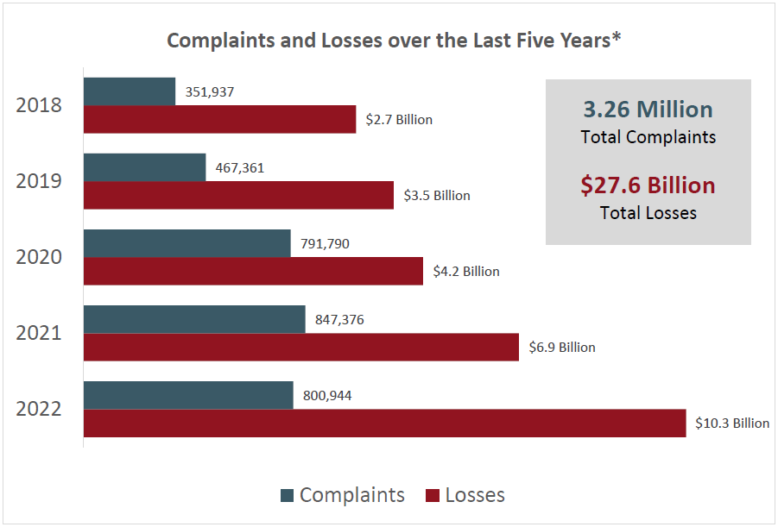

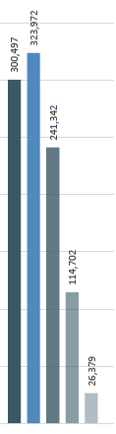

FBI’s Internet Crime Complaint Center (IC3) Five-Year Statistics
Notes:
FBI’s – Internet Crime Compliant Center 2021 Report – $2.4B lost to BEC

Slide 130


Breach Detection & Expense
You can’t afford to ignore cybersecurity – Especially now!
Public sector average total cost of a data breach is $2.07 million ($1.93)
In the U.S., average total cost of a data breach is $9.44 million ($9.05)
Average cost per lost or stolen record is $161 ($146)
Companies with an incident response team & extensive testing of their response plans
saved over $2 million compared to those who did not
Mean time to identify a breach
207 days
Mean time to contain
70 days
Source: Ponemon Institute 2022 Cost of Data Breach Study

Slide 131
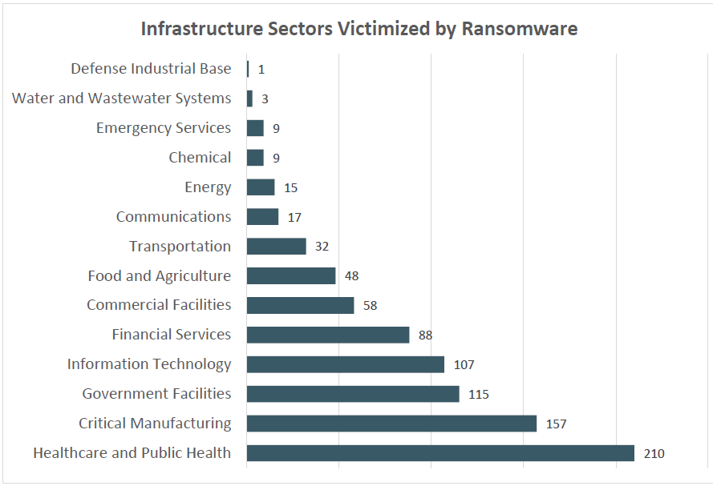
IC3 – Ransomware Fast Facts
**The average downtime for a ransomware incident is 16 to 21 days**
For 2022, the FBI’s IC3 received 2,385 (down from 3,729) complaints identified as ransomware with adjusted losses of more than $34.3million ($49.2 prior)
Notes:
https://www.ic3.gov/Media/PDF/AnnualReport/2021_IC3Report.pdf

Slide 132
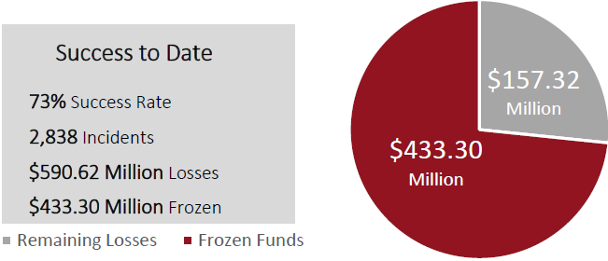
IC3 – Business Email Compromise (BEC)
In 2022, the IC3 received 21,832 complaints of Business Email Compromise (BEC)/Email Account Compromise (EAC) complaints with adjusted losses at nearly $2.7 billion ($2.4 prior). Note - Increased three years in a row.
IC3 Recovery Asset Team (RAT) Guidance
Contact the originating financial institution as soon as fraud is recognized to request a recall or reversal & a Hold Harmless Letter or Letter of Indemnity
File a detailed complaint with www.ic3.gov. Include all account data.
Visit www.ic3.gov for updated PSAs regarding BEC trends and targets
Never make any payment changes without verifying the change with the intended recipient; verify email addresses are accurate when checking email on a cell phone or other mobile device
Notes:
BEC/EAC is a sophisticated scam targeting both businesses and individuals performing transfers of funds. The scam is frequently carried out when a subject compromises legitimate business email accounts through social engineering or computer intrusion techniques to conduct unauthorized transfers of funds. The scheme has evolved from simple hacking or spoofing of business and personal email accounts and a request to send wire payments to fraudulent bank accounts. These schemes historically involved compromised vendor emails, requests for W-2 information, targeting of the real estate sector, and fraudulent requests for large amounts of gift cards. Now, fraudsters are using virtual meeting platforms to hack emails and spoof business leaders’ credentials to initiate the fraudulent wire transfers. These fraudulent wire transfers are often immediately transferred to cryptocurrency wallets and quickly dispersed, making recovery efforts more difficult.
They do so by compromising an employer or financial director’s email, such as a CEO or CFO, which would then be used to request employees to participate in virtual meeting platforms. In those meetings, the fraudster would insert a still picture of the CEO with no audio, or a “deep fake” audio through which fraudsters, acting as business executives, would then claim their audio/video was not working properly. The fraudsters would then use the virtual meeting platforms to directly instruct employees to initiate wire transfers or use the executives’ compromised email to provide wiring instructions.

Slide 133
Cybersecurity Threats & Impacts

Slide 134




Breach Impacts
Damage to brand
Deceptive or unfair trade charges
Regulator
scrutiny
Reputation Risk
Regulatory response
Cybersecurity Event
Negative publicity
!
Damaged employee relationships
Regulatory sanctions
Financial loss
Regulatory fines
Damaged third-party relationships
Operational Disruption
Diversion of
resources
Costs of recovery
Legal
liability
Lost productivity

Slide 135
Why Are Your Sectors a Target?
Aging infrastructure*, limited revenue sources, regulatory changes, etc.
Significant budgetary constraints
Public Sector = Significant amount of sensitive data
Threat actors can remain undetected for long periods of time
You need more cyber-skilled employees

Slide 136
Most Common Cybersecurity Threats
Social engineering attacks – phishing
Business email compromise
Supply chain attacks
Malware/destructive malware
Ransomware (Lockbit, Blackcat, HIVE)
Remote access
Keyloggers
Cloud applications/web applications (Azure, AWS, GCP)
Artificial Intelligence (AI) – ChatGPT / Bing AI / Google’s Bard
Root causes of cyberattacks: Inadequate training, ineffective patch management*, weak privileged access controls, & unmonitored detection systems
Top Five Most Affected Websites for Phishing
Tiktok.com (delete now!)
Instagram.com
Facebook.com
Linkedin.com
Discord.com
Notes:
Discord are scams and phishing attacks. Scammers often create fake profiles and try to friend people to steal their personal information. They may also create fake gaming servers to trick people into joining and stealing their information.

Slide 137
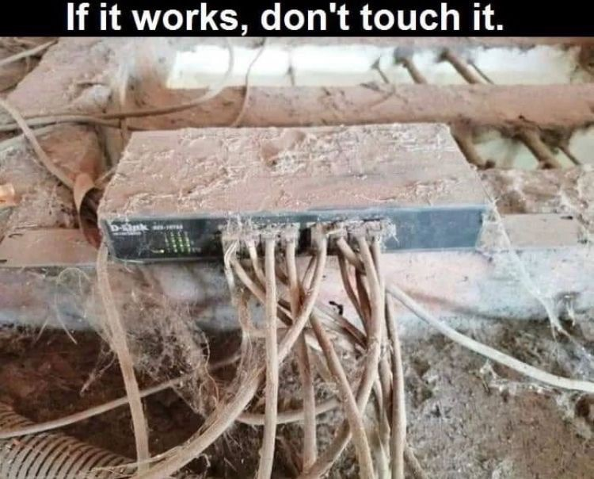
End of Life Systems
Costs of recovery

Slide 138
AI Threats and Early Mitigation
Phishing / Deep Fakes
AI can be used to automate and enrich phishing emails
AI can be used to impersonate individuals (Eleven Labs / Synthesia) for vishing
Data Privacy / Breaches
AI can be used to access and exploit personal data without permission or authorization
Al-assisted Fraud
Al-assisted fraud can be used to bypass security measures and steal data.
Other Security Risks
AI can be used to create security vulnerabilities or exploit weaknesses quickly
Mitigate the Threat - Start with the Basics:
Address the threat / usage in your risk assessments
Address usage in your Acceptable Use Policies
Train and educate employees!
Notes:
The higher the role level given, the greater the risk if there are insufficient preventive and detective controls to guard against the consequences of system errors and failures.

Slide 139
Cybersecurity Events/News – Past 16 Months
Dallas, TX – Ransomware Attack (May 2023)
Raleigh Housing Authority – Ransomware Attack (May 2023)
LastPass – 33 million customers impacted
Los Angeles Unified School District – 250,000 files compromised
California Transit – Data exposure (unknown)
T-Mobile – 37 million customer’s data breached
Public Sector: Atlanta, Georgia; Baltimore ($10M), Maryland; St. Lucie, Florida; New Orleans, Louisiana; and Greenville, North Carolina
Notes:
LA Schools - Vice Society stole roughly 500 gigabytes of data and posted about 250,000 files on the dark web, some containing Social Security numbers, contracts, W-9 tax forms, invoices and passports, according to data observed by threat researchers at Check Point.
U.S Marshall Service hit by ransomware as well. Down 10 weeks.

Slide 140

“You” Are the Target
Importance of Awareness Training
Leaders and executives are 12 times more likely to be the target of social engineering attacks
Are you trained more than employees?
If not, why?

Slide 141
Industry Best Practices

Slide 142
IT vs. IS – Both Have Their Roles
Information Technology | Information Security
Top priority: Ensuring hardware, software, network, etc. remains functional | Top priority: Protecting data & assets at all costs
Responsible for new technology implementations & maintenance | Responsible for systems, processes, & risks posed by end users
Puts controls in place | Monitors controls to ensure they work as designed
Stays up to date on new hardware, software, & solutions | Stays up to date on new threats & developments that emerge daily
Often measured in uptime & response times | Recommends & prioritizes action steps & solutions
“Fix-it” mentality | “Secure-it” mentality

Slide 143

Key Considerations: Focus on Governance Controls
Maintain a strong information security program
Maintain a strong incident response program
Ensure business continuity/DR & vendor management policies & procedures address cybersecurity
Consider how cybersecurity insurance should fit into your risk management program
Ensure cybersecurity awareness training is performed regularly (educate & motivate)
Join an information sharing & analysis center (ISAC) or other information sharing forums – filter reports based on each employees’ role
Perform frequent cyber risk assessments, penetration tests, vulnerability assessments, cloud / ransomware assessments, etc.

Slide 144
Key Considerations: Focus on Technical Controls
Use multifactor or two-factor for O365, VPN, remote sessions, & privileged access (restrict push requests)
Track, report, independently test, & update security patches based on a risk priority schedule (Microsoft & non-Microsoft patches)
Maintain accurate asset inventories for hardware & software, including data classification
Enforce application whitelisting controls & remove unauthorized applications
Remove local administrator rights to reduce malicious software installs
Constantly adjust existing security tools – web content, email filtering, end point, etc.
Deploy cloud-based security software & end-point protection (SentinelOne, Crowdstrike, Windows Defender, etc.)

Slide 145
Key Considerations: Technical Controls
Implement strong cloud-based data loss prevention controls
Use security information & event management (SIEM) tools with “defense in depth” approach
Strengthen your passwords! Do not use dictionary words.
Ensure data encryption is enforced to protect confidential data
Segment internal networks to isolate critical systems
Be aware of insider threat – layoffs, disgruntled, etc. Think zero trust!
Air gap your backups to keep them out of reach of an attack
Make your air-gapped backups immutable!

Slide 146
Final Thoughts & Conclusion

Slide 147
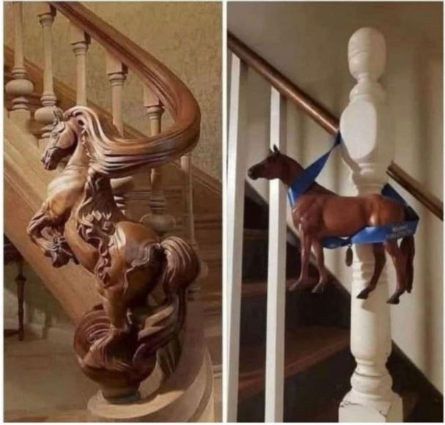
A Dangerous Perception
Perception of Your Security Controls
Your Actual Security Controls
vs.
Notes:
Test! Validate!

Slide 148
A Quote to Motivate
“Life is like riding a bike. To keep your balance, you must keep moving.”
- Albert Einstein
Notes:
Take action. You may be the only one who does.

Slide 149
Other Resources
Infosec Institute – https://resources.infosecinstitute.com/
Info Risk Today – https://www.inforisktoday.com/
Security Week – https://www.securityweek.com/
Dark Reading – https://www.darkreading.com/
The Top Cyber Threat Intelligence Feeds – https://thecyberthreat.com/cyber-threat-intelligence-feeds/

Slide 150
Questions?
Email: cy.sturdivant@forvis.com
Phone: 615.988.3596

Slide 151
Thank you!

Slide 152
TRIVIA TIME

Slide 153
Unleashing Innovative Ideas
Tondeé Lutterman
National Industry Partner
René Larsen
Senior Managing Consultant
Nonprofit, Education & Public Sector
Notes:
Tondee and Rene (2.5 min)
Introductions – who we are and why innovation matters to us..
My story about my interaction with Holly Buckendahl… how change happens. Not by staying in the box!

Slide 154
Introduction
Lego Challenge
See and Think Differently
5 Whys
Negative Idea Generation
Problem Exercise
Notes:
Rene (45 sec)

Slide 155
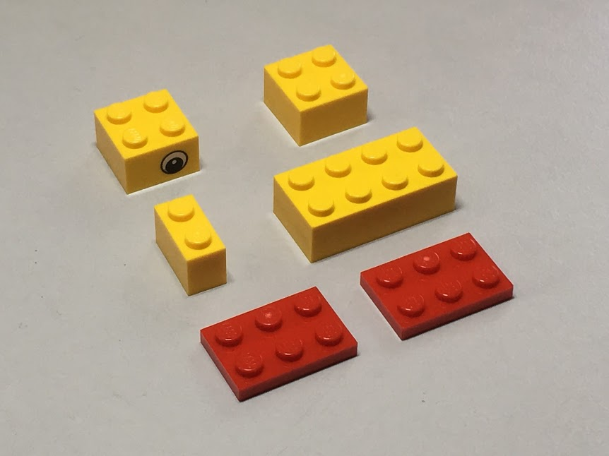
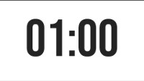
– Build a Duck
Lego Challenge
Three rules:
You have one minute
Use any or all of the six pieces, but use only your six pieces
No peeking at the people next to you
www.RobertsonInnovation.com
Notes:
Tondee (5 min)

Slide 156
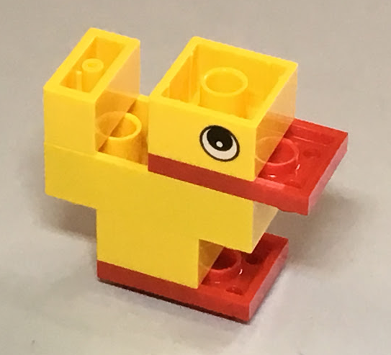
Post Duck Reflection
How many different ducks do we have?
What skills are used to make a LEGO duck?
What lessons did you learn?
What things would you try next time?
Notes:
Tondee
Have someone count how many different ducks we have and how many are the same?
The adult brain puts parameters that can sometime limit creativity
Shows us how many different ways there are to solve the same problem
Play is an excellent lead-in to innovation (discussions and activities)
Helps unleash creative thinking that can accelerate innovation
It gets the brains primed and juiced – so now they are ready for more

Slide 157
See and Think Differently
Notes:
Rene (30 sec) We are going to challenge you to think irrationally – crazy talk for a bunch of accountant types I know. Irrational thought is the beginning of free thinking. Free thinking is what starts to develop truly innovative ideas.

Slide 158


Let’s start with an EASY Question. What color is the Yield sign?
See and Think Differently
Notes:
Rene (1.25 min)

Slide 159
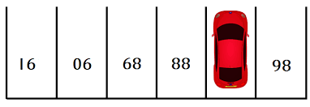
What’s the Missing Parking Spot #?
See and Think Differently
Notes:
Rene (2 min)

Slide 160

See and Think Differently
Challenge Assumptions
Notes:
Rene (2 min) I always start at the end. And always felt bad in doing so like I was cheating. Can build on this with #21. If we want to get truly uncomfortable with a room of rule followers - what if we look at another angle and tore down the barriers instead of just finding the path of least resistance. Not load bearing ones of course! Just see and think differently

Slide 161

The 5 Whys
Notes:
Rene (1.25 min)
Channel your inner child – will help you arrive at THE problem to solve, not A problem to solve. Solving at the right level ensures you aren’t just elevating a new problem. This helps you identify the root cause of an issue.

Slide 162
Creating 5 Whys
Why is it down?
Revenue is up 6% over prior quarter, but personnel costs are up 21% over prior quarter
Why are personnel costs up 21%
Net Income down in Q4
We still have a staff shortage so are paying overtime to get shifts covered
Why is there still a staff shortage?
Our offers are not being accepted
Why are our offers not accepted?
Conclusion: We need to update our compensation to be competitive
Our rate of pay is less than our competitors
Why are we not paying competitive rates?
Our pay is based on a study from 2018
Notes:
3 min
Channel your inner child – will help you arrive at THE problem to solve, not A problem to solve. Solving at the right level ensures you aren’t just elevating a new problem.

Slide 163
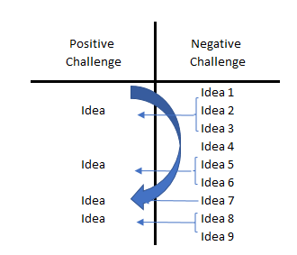
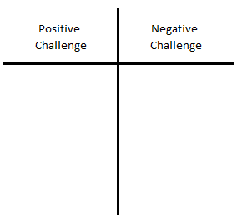

Negative Idea Generator
Solve the opposite problem
Turn the situation upside-down and generate ideas for the new, opposite situation
This is a very powerful and fun method
Let’s give it a try!
Adapted from Modern Management Network, Malmo, Sweden
Notes:
Tondee (2 min to talk about, 3 min for exercise)

Slide 164
Table Exercise – Solve the Opposite Problem
Present the challenge
Reformulate the challenge in the negative
Generate ideas to the negative
Transform these ideas to the positive
Create a new shopping cart
Create the worst possible shopping cart
List ideas for the worst possible shopping cart
Transform your bad ideas into ideas for the best shopping cart
Adapted from Modern Management Network, Malmo, Sweden
Notes:
Tondee (2 min to talk about, 3 min for exercise)
Table Exercise
With your table, list as many ideas as possible for the worst possible shopping cart – 60 seconds
Transform these ideas to the positive – 60-90 seconds
Don’t just do this translation idea by idea, but see if you can combine many negative ideas to generate a single positive solution
Have people share after each breakout

Slide 165


Applying Innovative Thinking to a Real-World Problem
Think about a challenge you and/or your organization are currently experiencing
Take 10 minutes to review what we’ve learned and try applying a new, innovative approach to your challenge:
Lego Challenge
See and Think Differently
5 Whys
Negative Idea Generator
https://app.smartsheet.com/b/form/38f22374c8844c048dc1e0e19f8f727c
Notes:
Rene

Slide 166

Creating a Culture of Innovation
https://dianakander.com/speaking
Notes:
Rene

Slide 167
Thank You!

Slide 168


Slide 169
See you
next year!

